Slide 1

7 Ways
Holganix GROWS Healthier Turf
Notes:
Chapter one: What is Soil

Slide 2
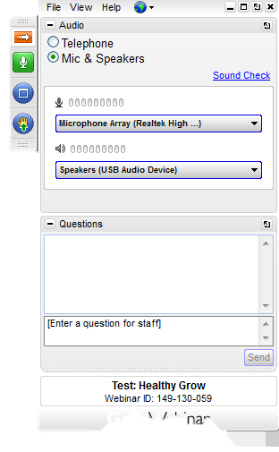
Webinar Semantics
If you have a question, type it here!
Notes:
What is soil?
Components of soil
Soil is home to biology
Q&A

Slide 3
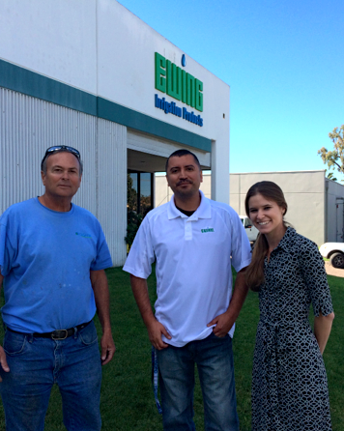
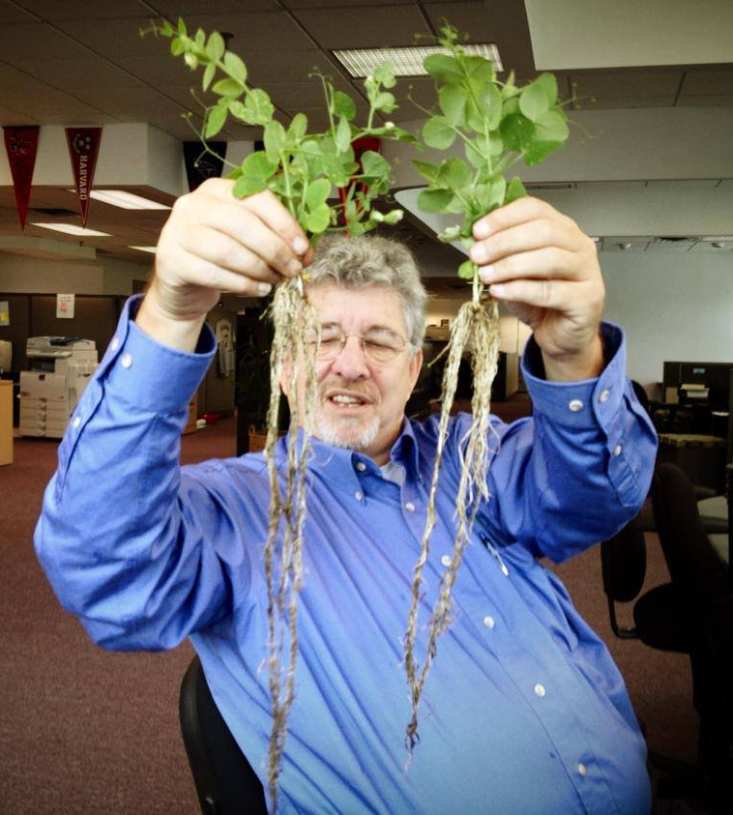
Meet your hosts!

Slide 4
What is Holganix?
“100% organic plant probiotic that balances soil’s ecosystem, building strong roots and growing healthier, more resistant plants”

Slide 5
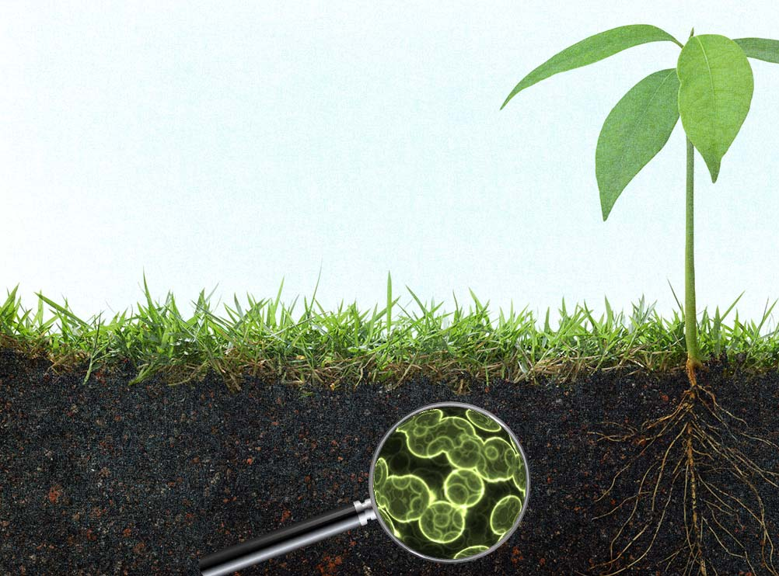
Holganix is made up of:
Living beneficial microorganisms
Biological food sources
Helpful plant extracts & soil minerals
Notes:
Have components list beside us

Slide 6
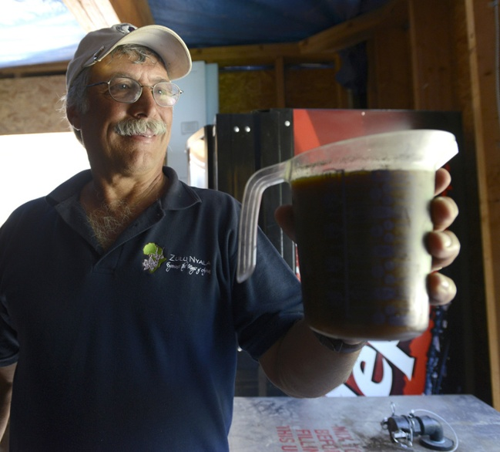
25+ University Studies
Used by top PGA golf courses, professional athletic fields, L&M Top 150 Lawn and Landscape Companies
Continually evolving the product
Notes:
Ed Michaud Fox Ridge GC in Maine

Slide 7
1
Holganix Balances
The Soil Food Web

Slide 8
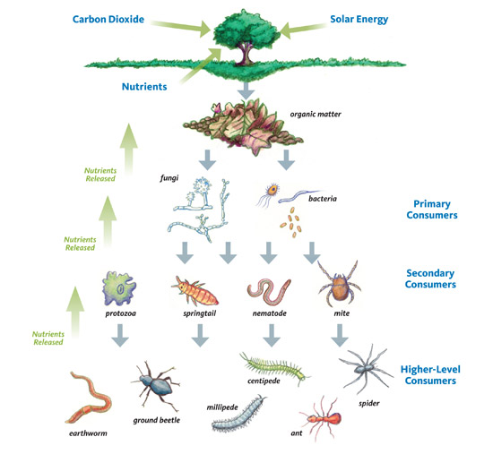
How does Holganix balance the soil food web?
Increases diversity
Increases population counts
Strengthens broken segments
Feeds soil food web

Slide 9
2
Holganix Builds Strong Roots

Slide 10
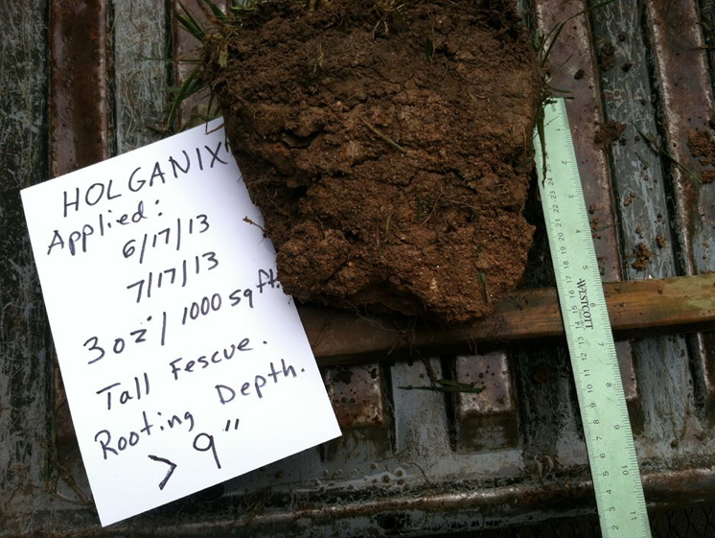
What are the benefits of a strong web-like root system?
Notes:
Growin Green Tommy Cowett North Carolina

Slide 11
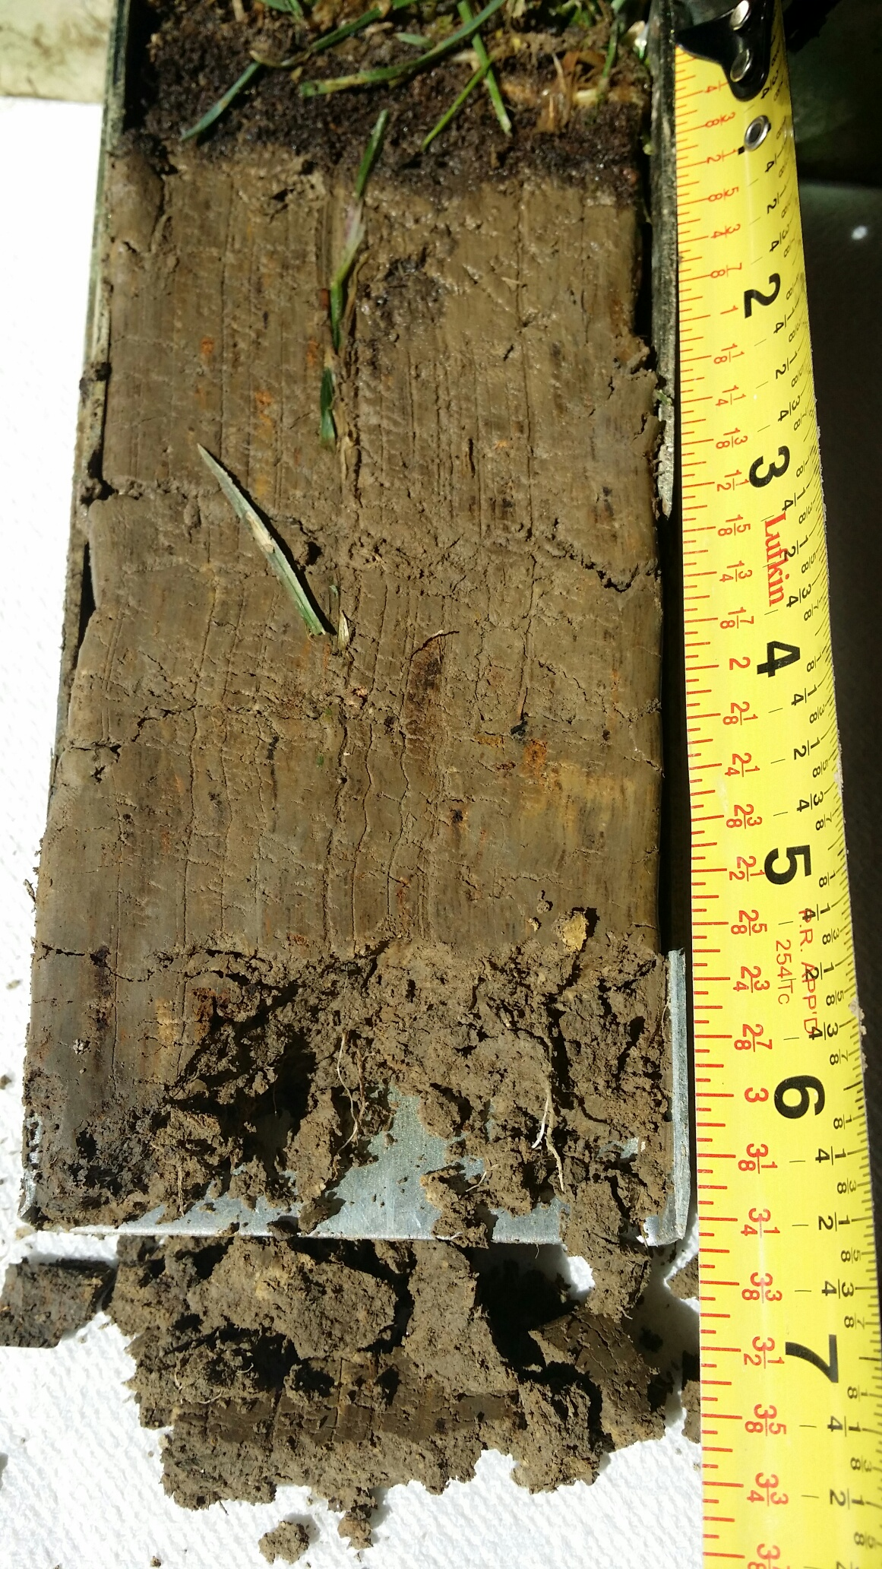
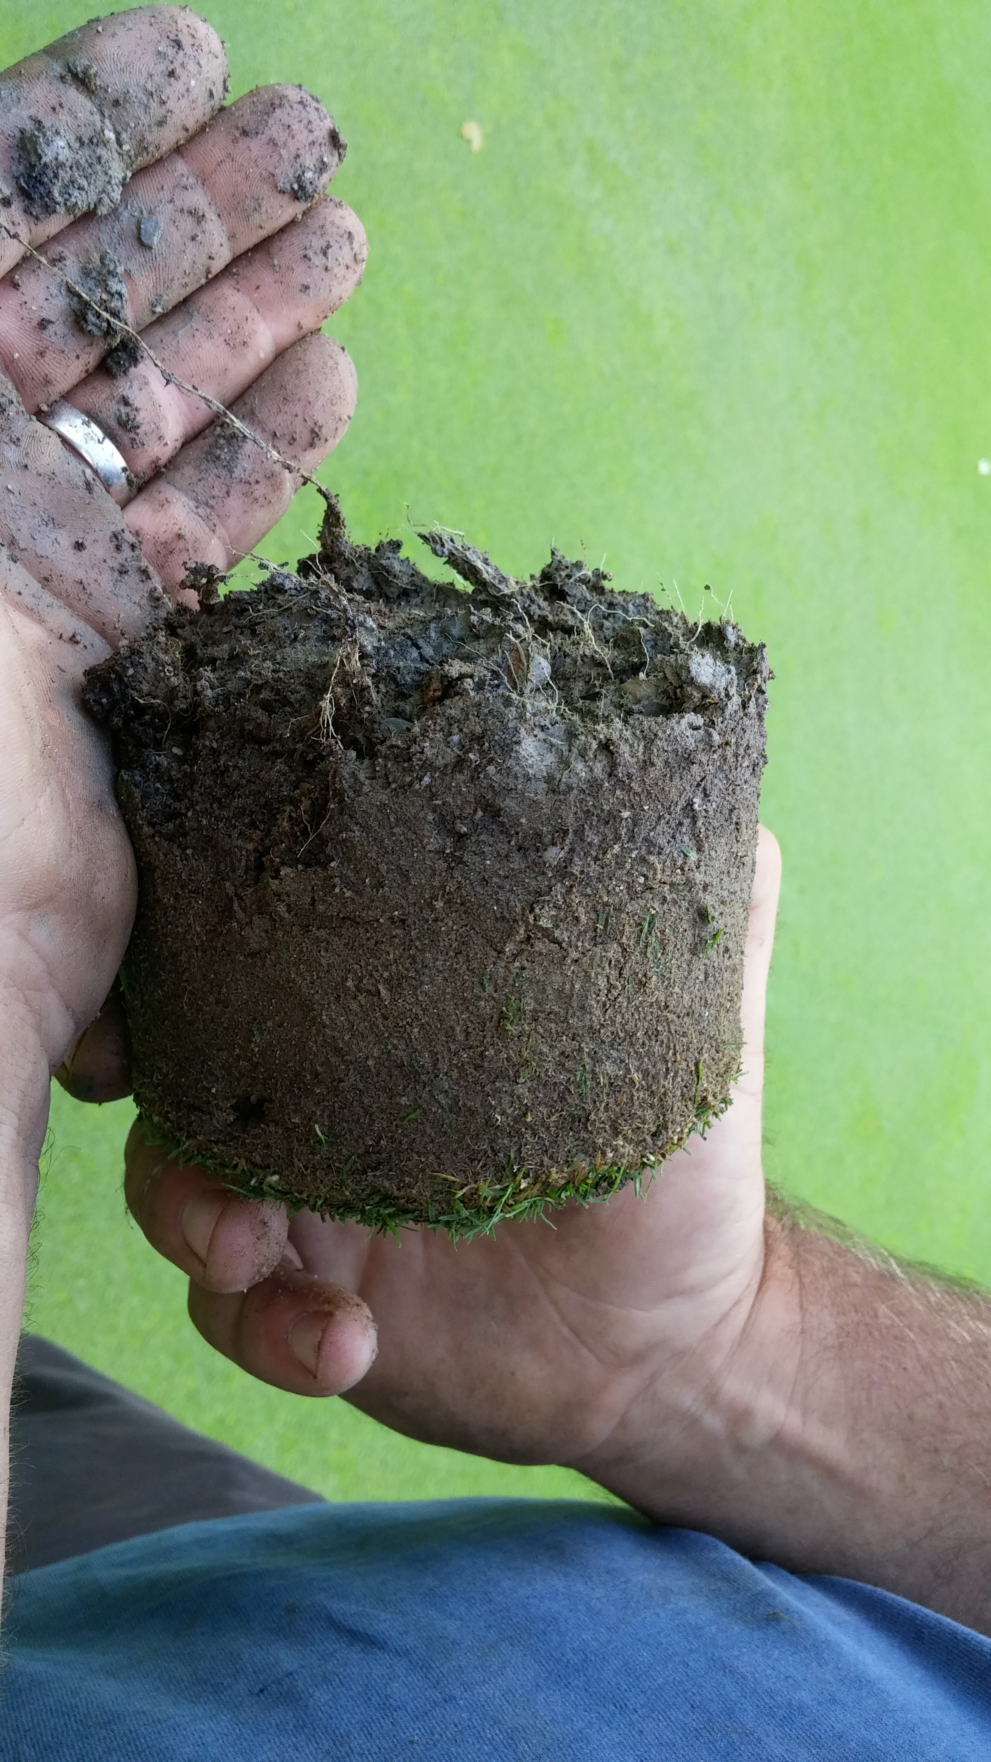
How does Holganix affect root growth?
Endo and Ecto Mycorrhizae Fungi
Trichoderma
Humic and fulvic acids
Saccharomyces cerevisiae
Plant growth promoting bacteria (PGPB)

Slide 12
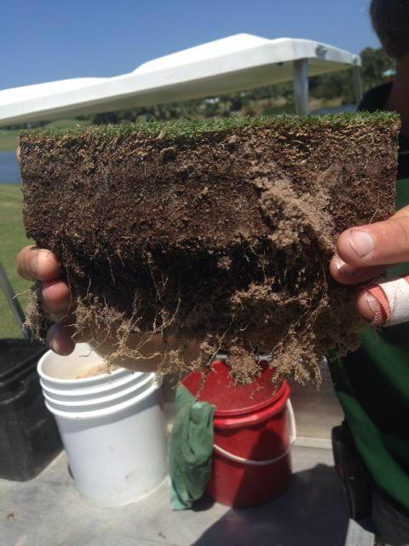
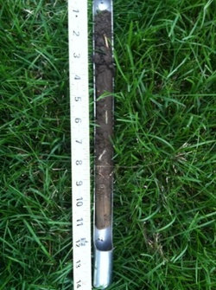
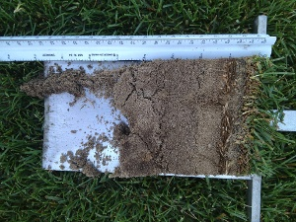
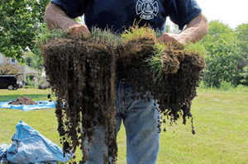
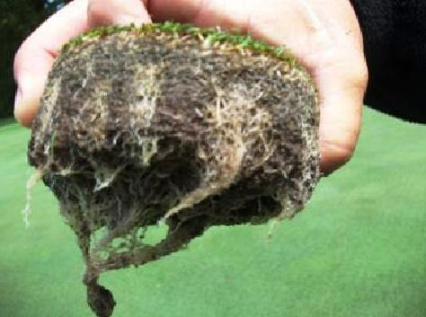
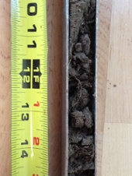
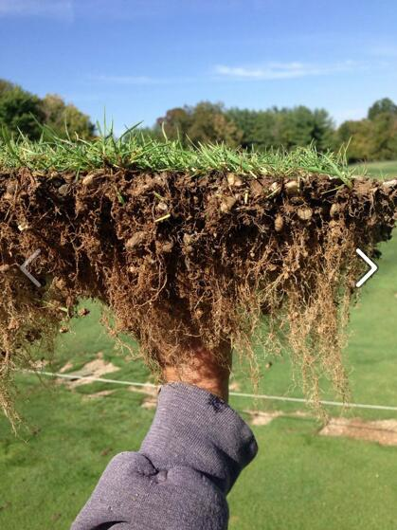
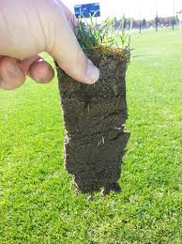
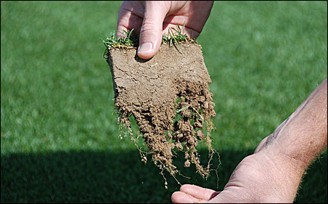

Slide 13
3
Holganix Reduces Inputs

Slide 14
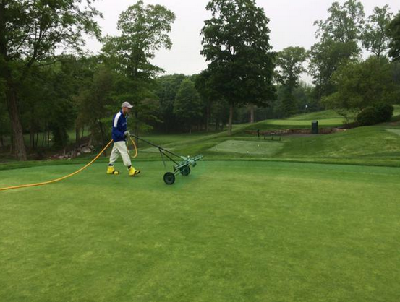
Up to 75% reduction in fertilizer and pesticide inputs
Notes:
Aspentuck GC applying HGX Golf

Slide 15
4
Holganix increases water efficiency

Slide 16
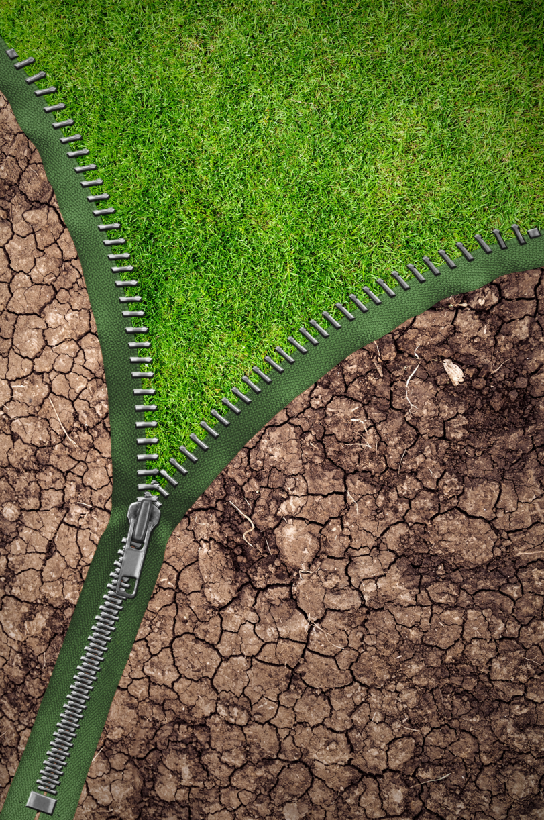
How does Holganix affect water efficiency?
Increase root mass
Mine for moisture
Open pores
Soil conditioner, wetting agent
Notes:
MYCORRHIZAE

Slide 17
5
Holganix increases stress tolerance

Slide 18
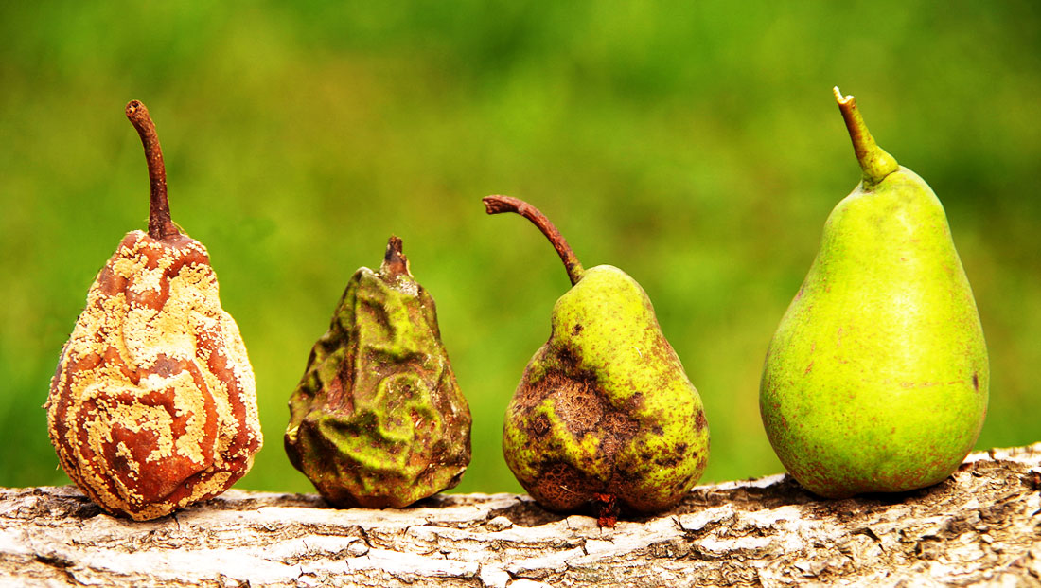
How does Holganix increase disease, pest, weather stress tolerance?

Slide 19
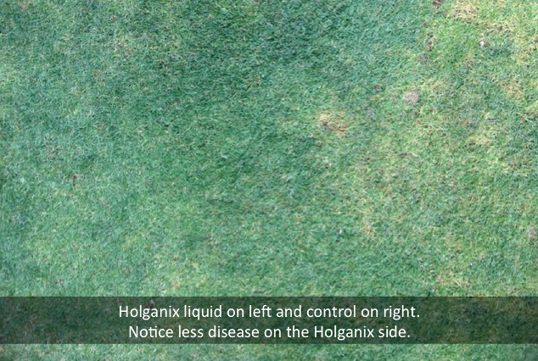
6
Holganix increases seed germination
Notes:
Manada gc Harrisburg PA

Slide 20
6
Holganix increases seed germination

Slide 21
How does Holganix increases seed germination?
Kelp Extract
Mycorrhizae Fungi
Nitrogen Fixing Bacteria
Trichoderma
Humic and Fulvic Acids
Amino Acids
Plant Growth Promoting Bacteria (PGPB)

Slide 22
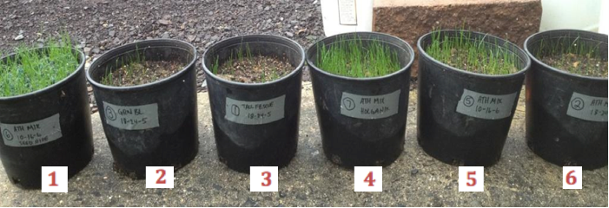
Which test plot was treated with Holganix?
Notes:
12 days after germination Terry Shafer Terry’s lawn care service IN

Slide 23
7
Holganix reduces transplant shock

Slide 24
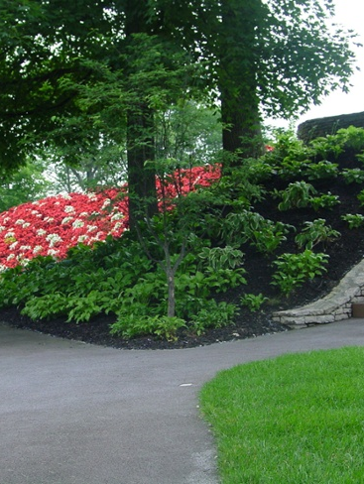
How does Holganix reduce transplant shock?
Builds strong roots
Increases stress tolerance
Mends disrupted soil food web

Slide 25
Any questions?

Slide 26
Conclusion:
Please take our survey!
Look for a follow up email with:
  A recorded version of this webinar
  Resources and information mentioned during the webinar

Slide 27
Additional questions?
Dr. Robert Neidermyer
Email: Rneidermyer@holganix.com
Phone: 866-56-EARTH ext
Kaitlyn Ersek
Email: Kersek@holganix.com
Phone: 866-56-EARTH ext 201

Slide 28
What’s in the Holganix Jug?
Download our ingredient list:
www.Holganix.com/Holganix-Ingredient-List

