Slide 1
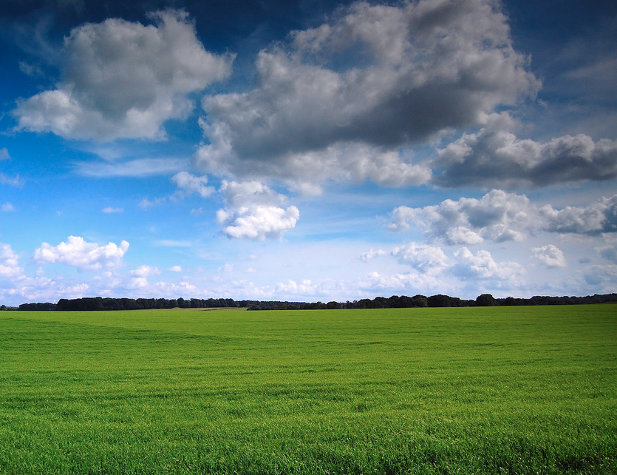
The Science Behind Holganix:
Trees and Shrubs
By Dr. Bob
Notes:
Your tittle slide

Slide 2
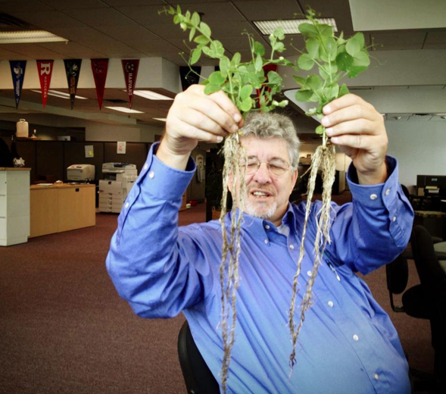
Dr. Bob
Director of Soil and Plant Sciences
rneidermyer@holganix.com
866-56-EARTH

Slide 3
Agenda
Lake Side Club
What’s going on in the jug?
Applying Tree and Shrub
Examples
Q&A

Slide 4

Does anyone currently use Holganix on Tree & Shrubs?

Slide 5
The Lakes Club
Notes:
Let’s figure out how many are prospects vs users?

Slide 6
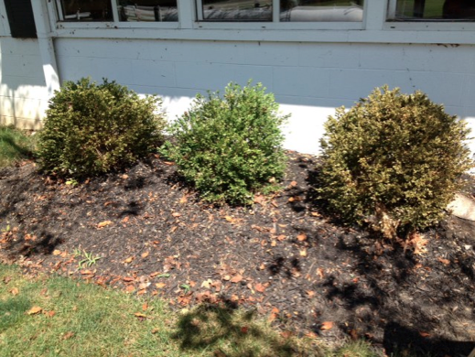
Holganix!
Notes:
Let’s figure out how many are prospects vs users?

Slide 7
Why?
Notes:
Let’s figure out how many are prospects vs users?

Slide 8
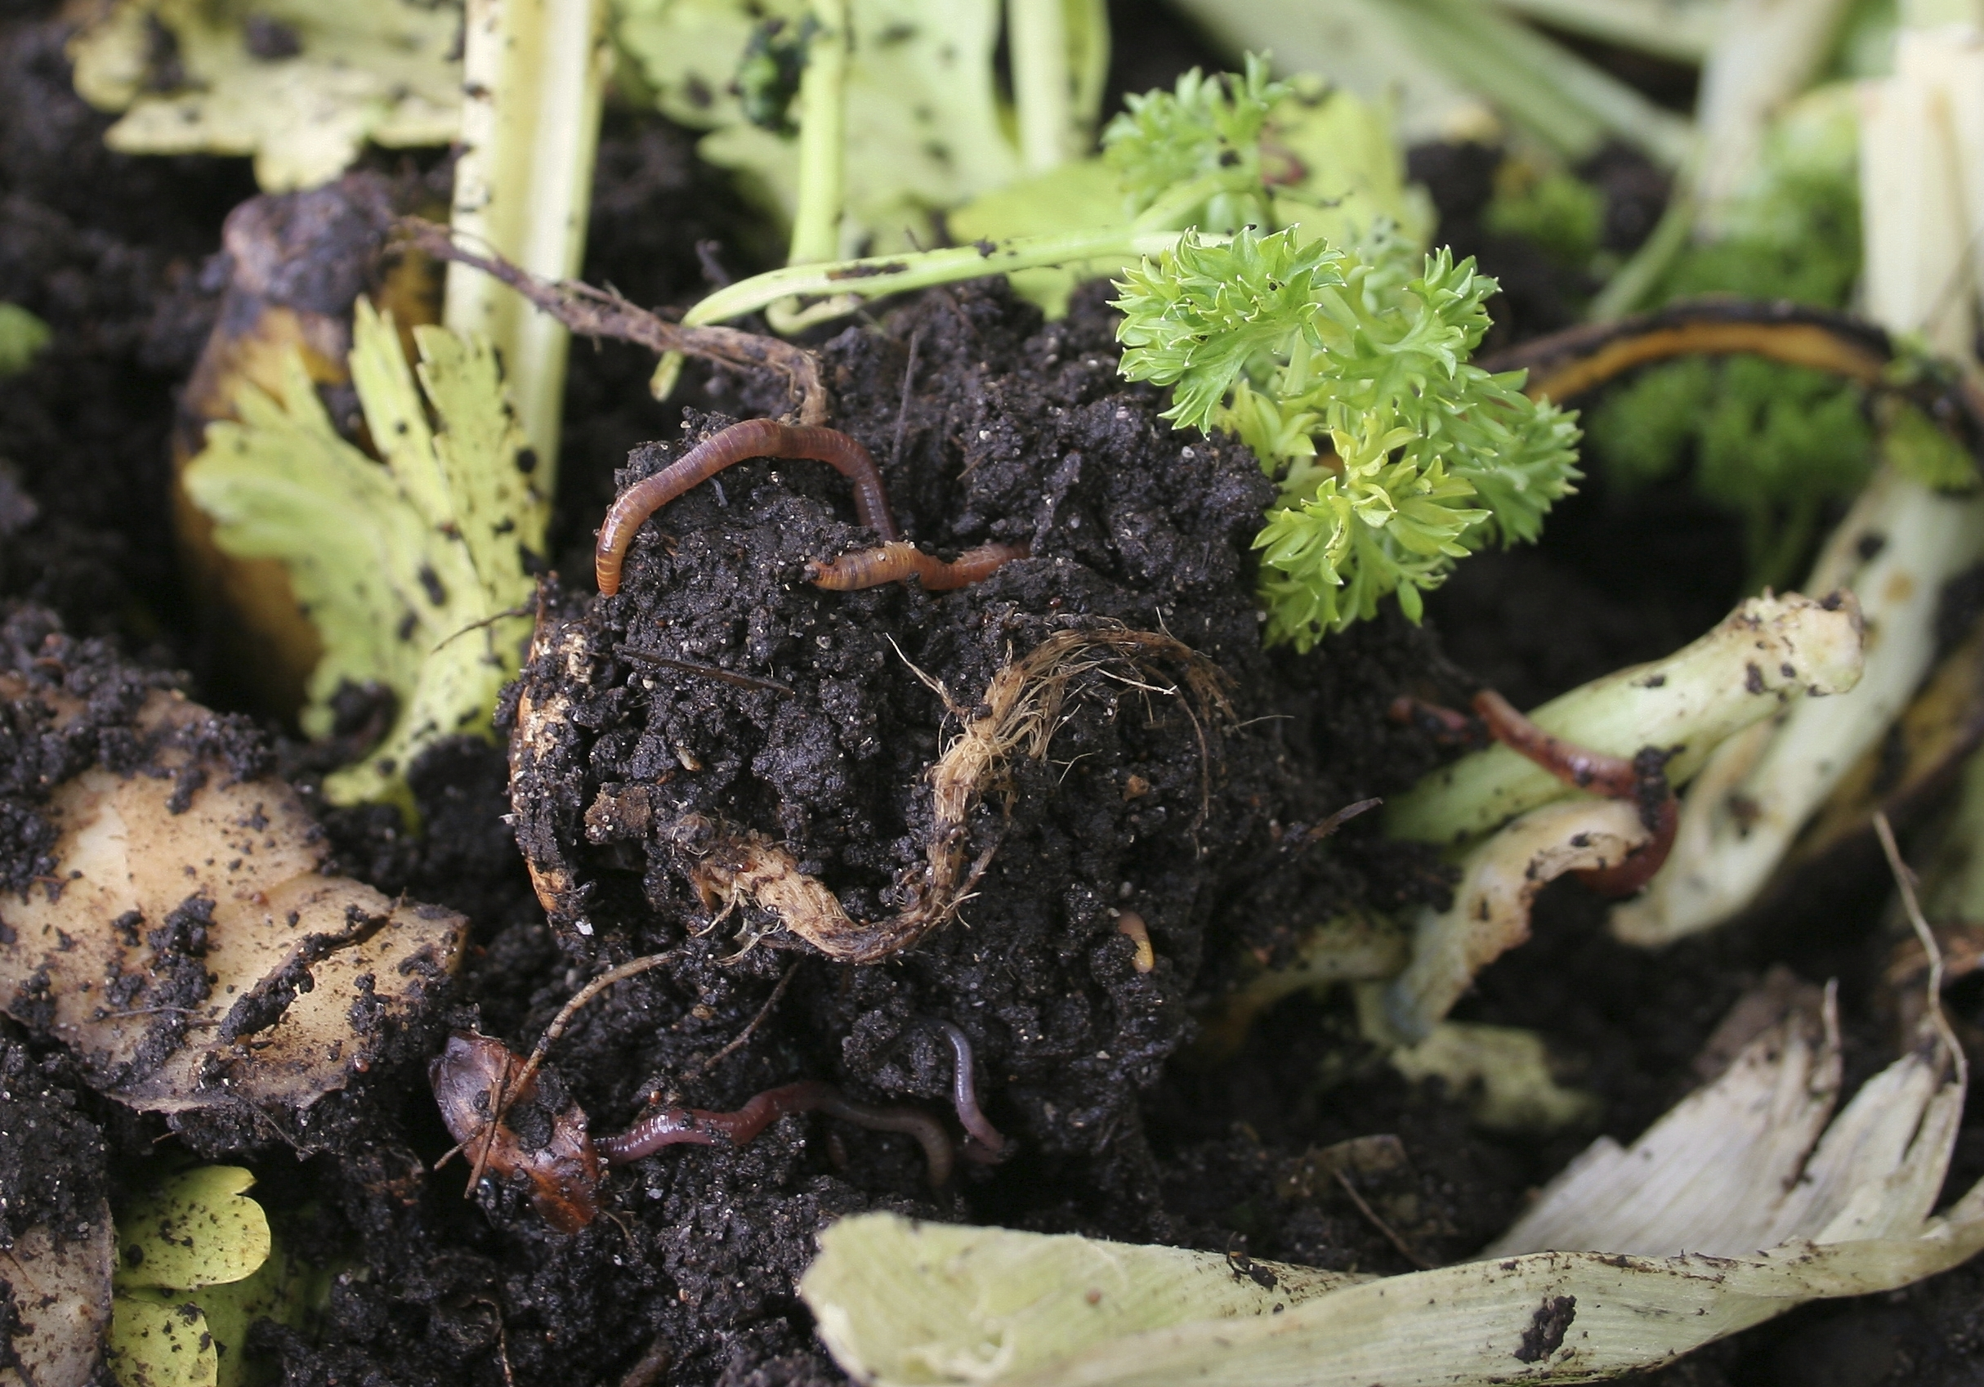
Key microorganisms
Key microorganisms
Notes:
Just as a refresher for prospects and new-bees

Slide 9
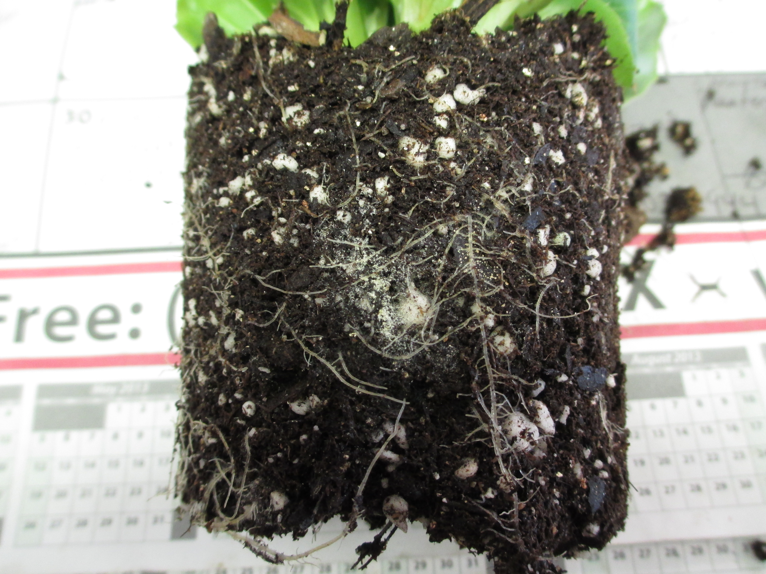
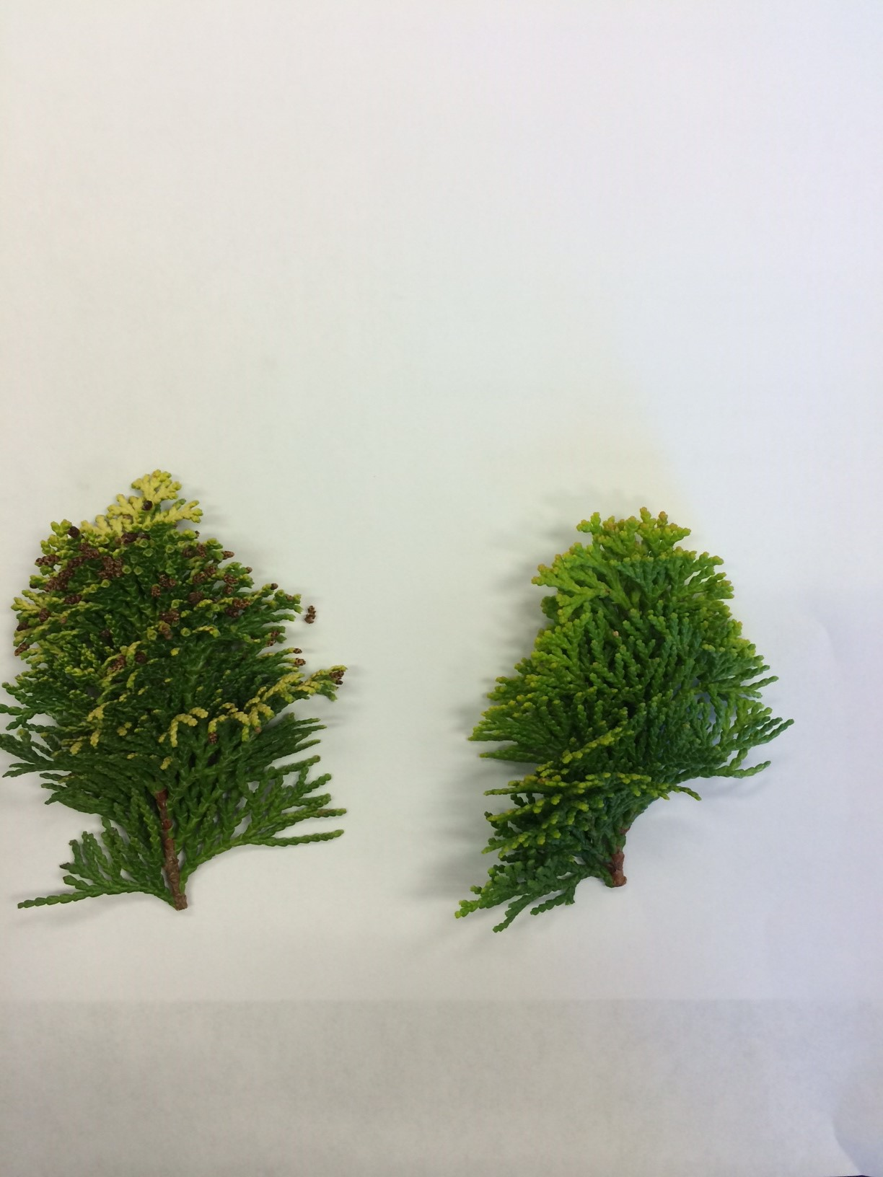

Slide 10
Do you have a story to share?
Notes:
Let’s figure out how many are prospects vs users?

Slide 11
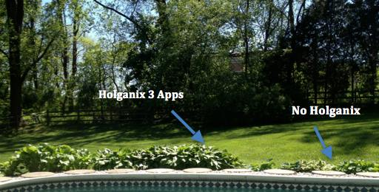
Hosta comparison

Slide 12
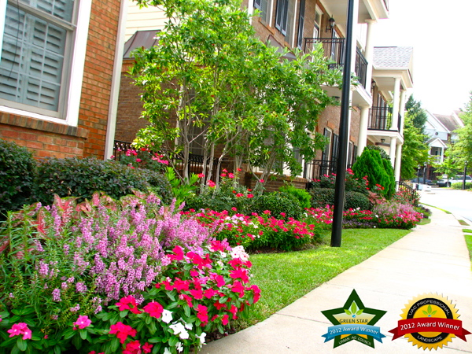

Slide 13
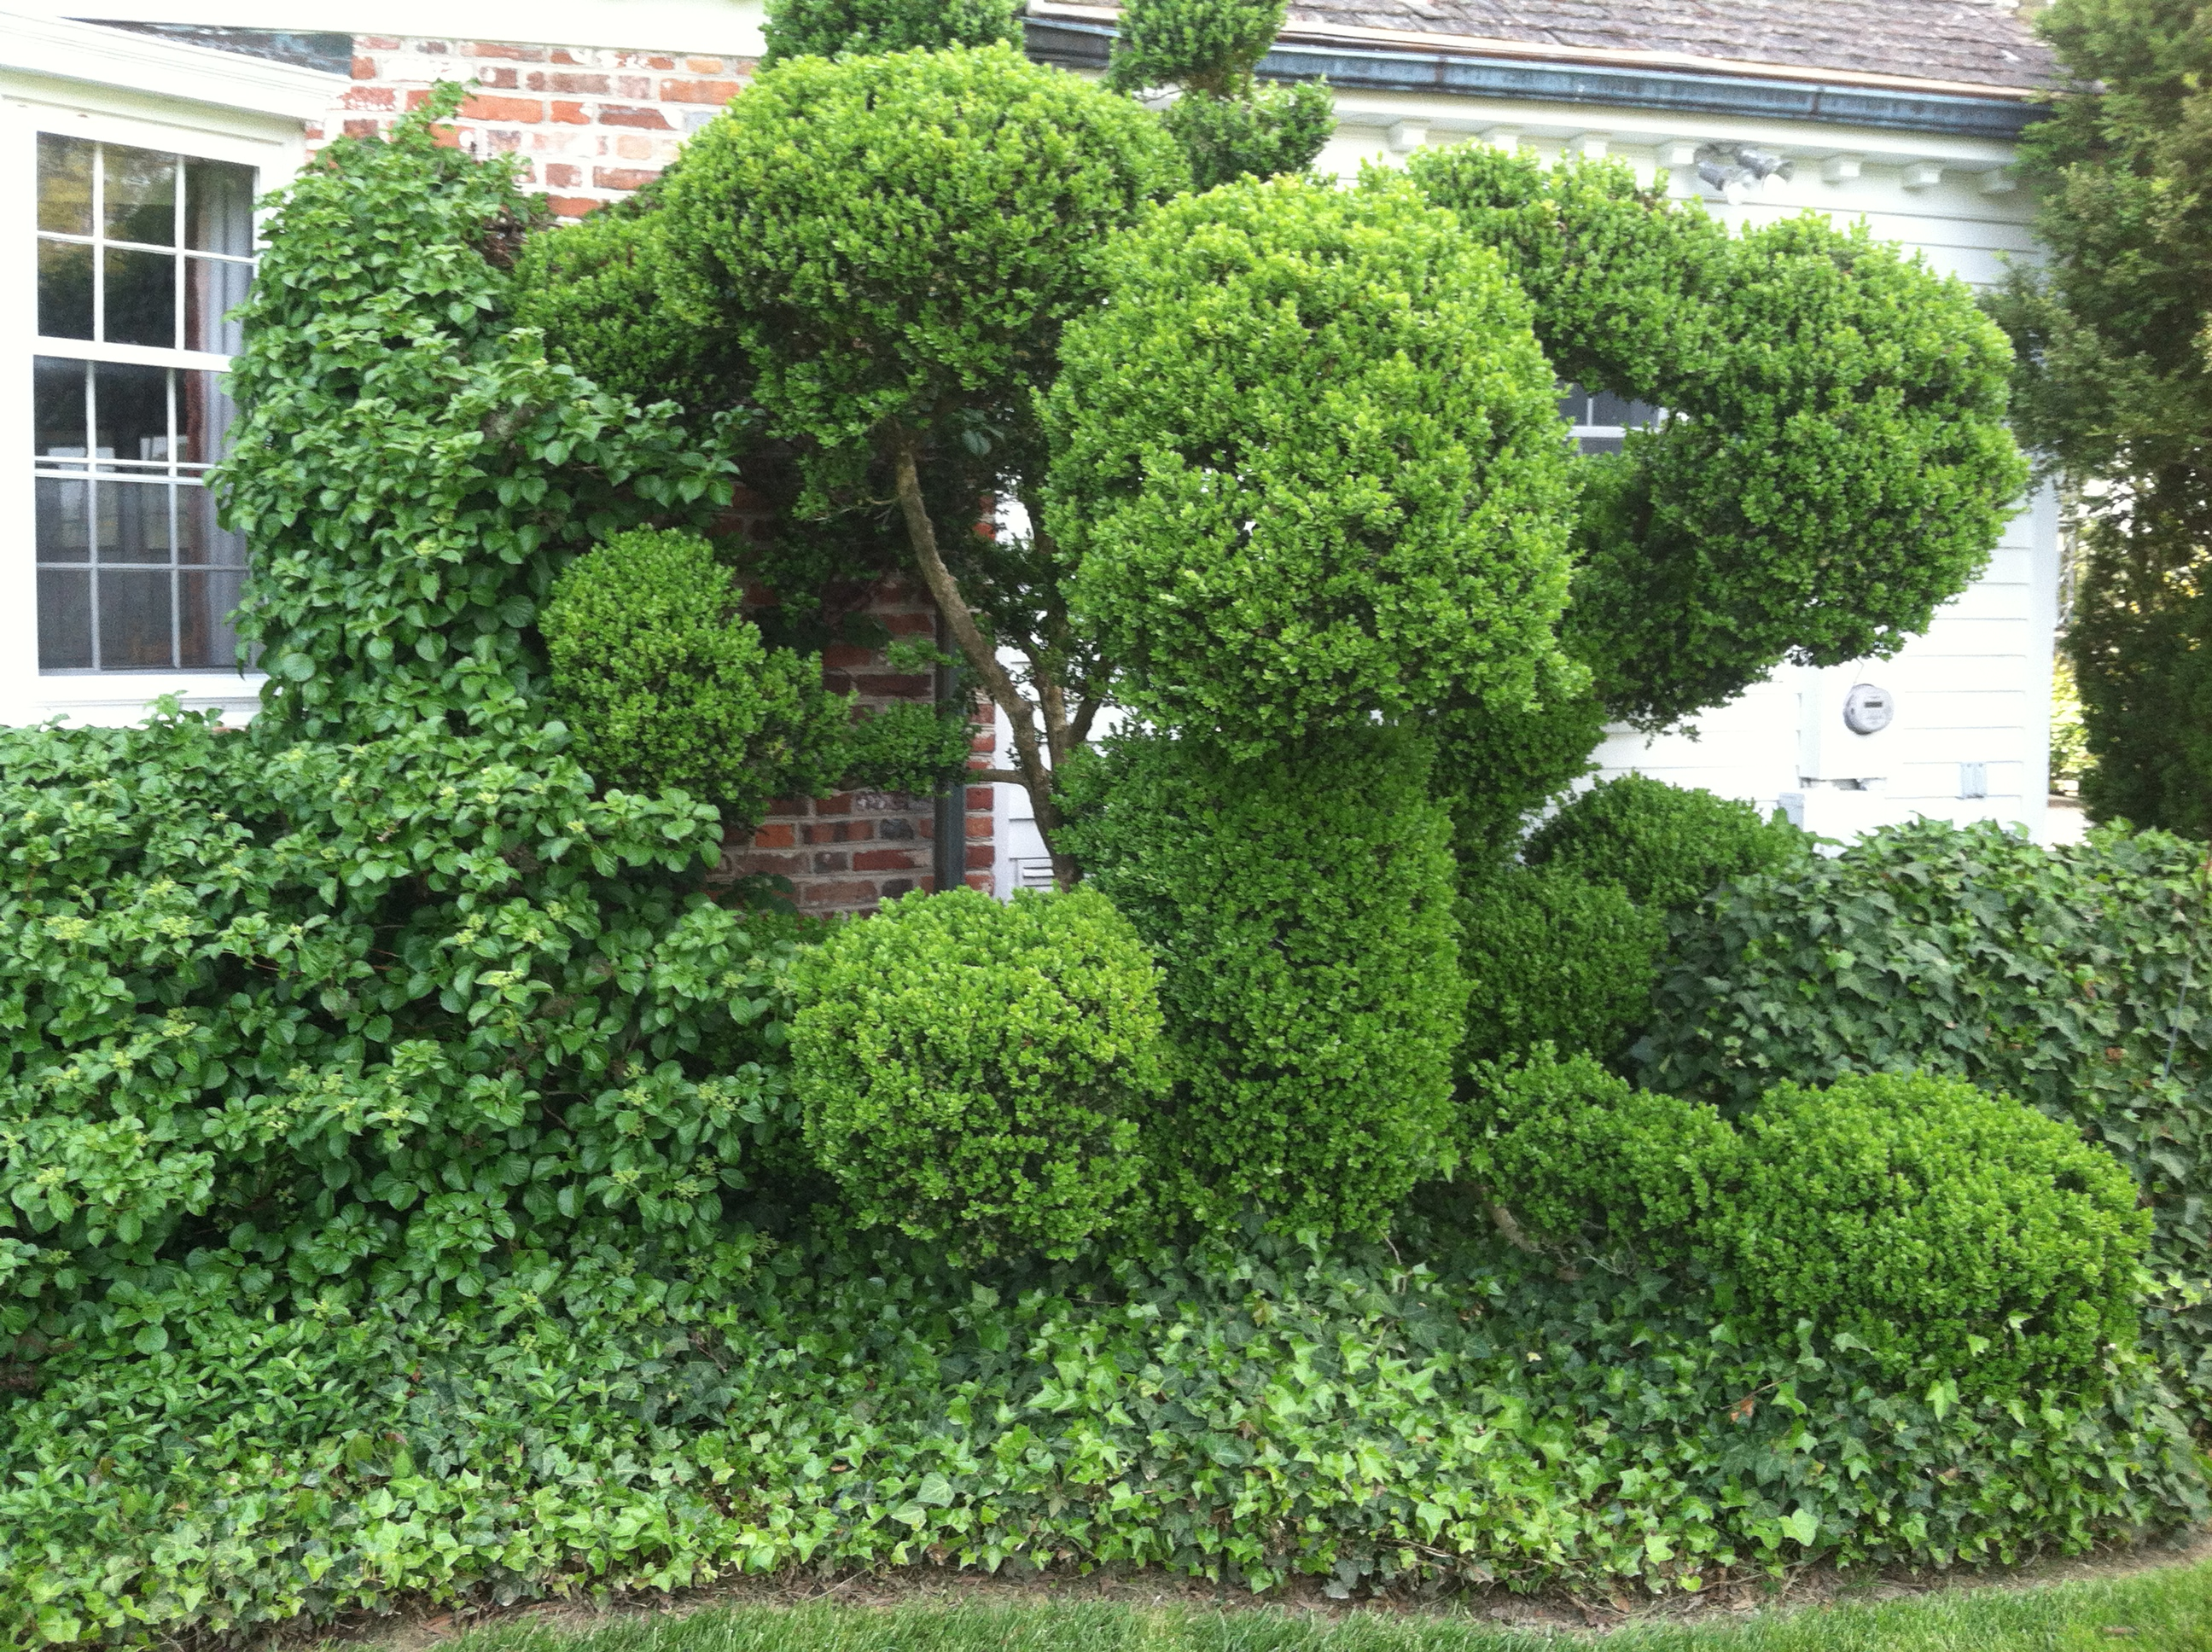
Topiaried English Boxwood
200+ old

Slide 14
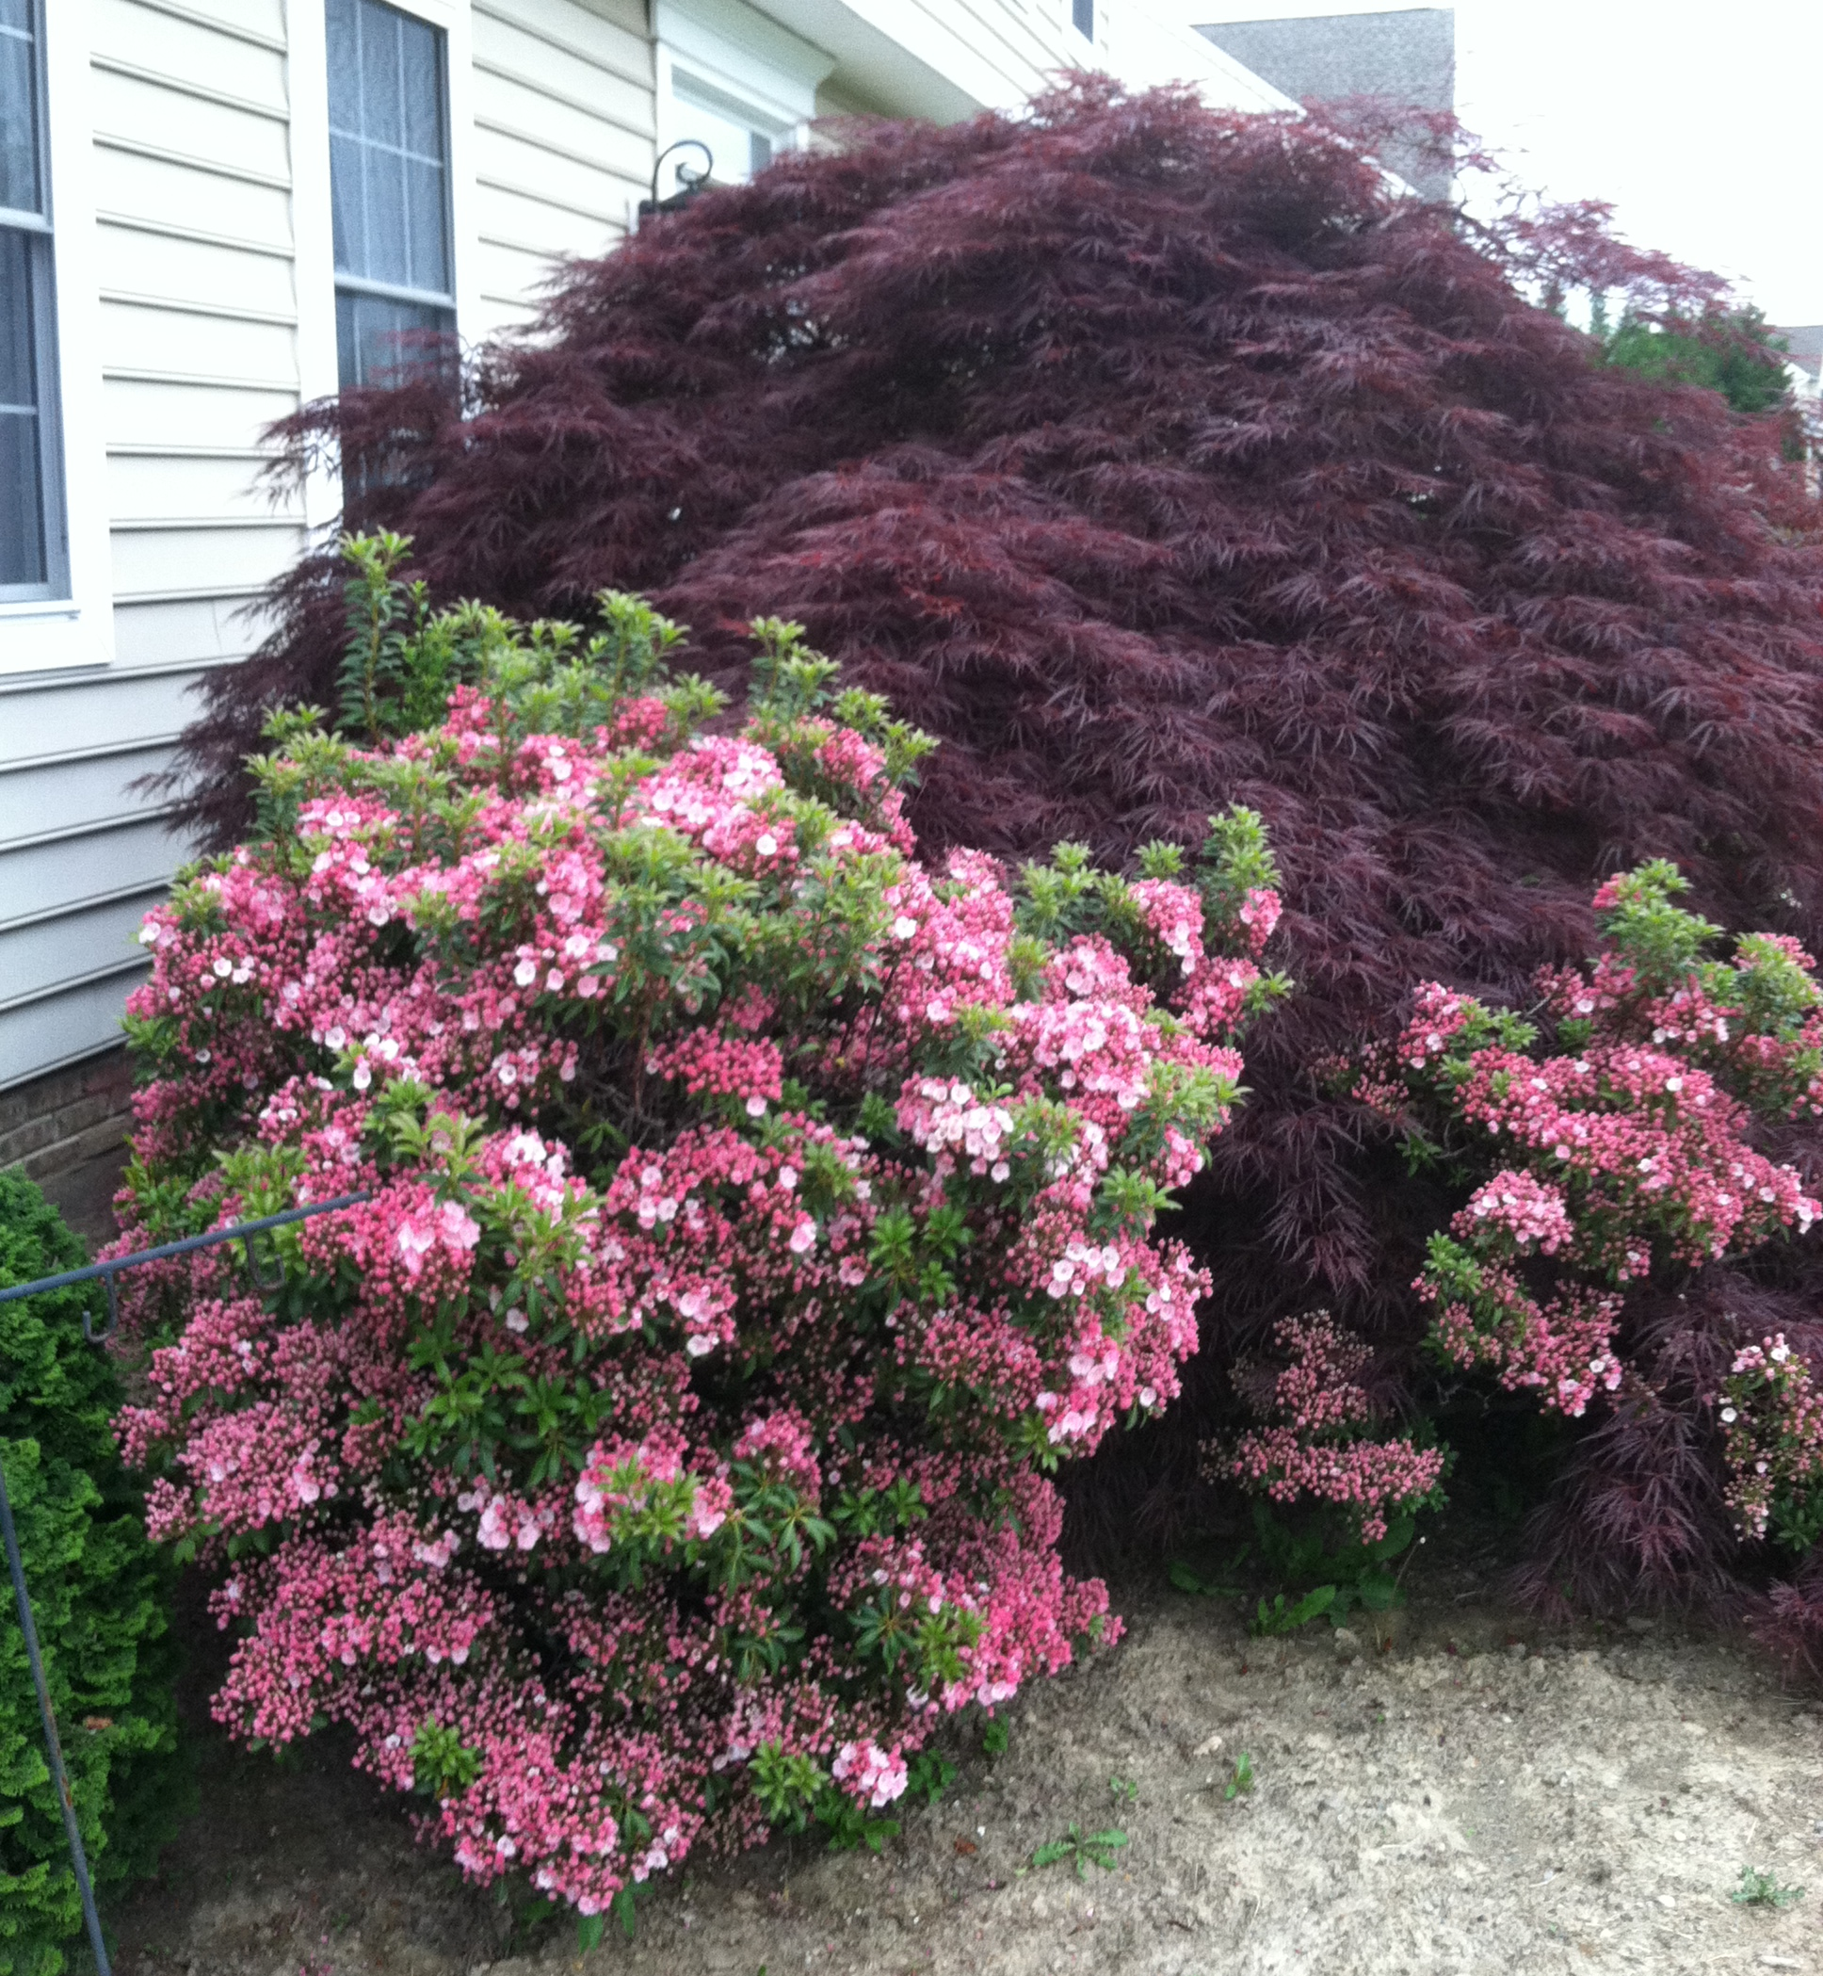
Mountain Loral & Japanese Red Maple

Slide 15
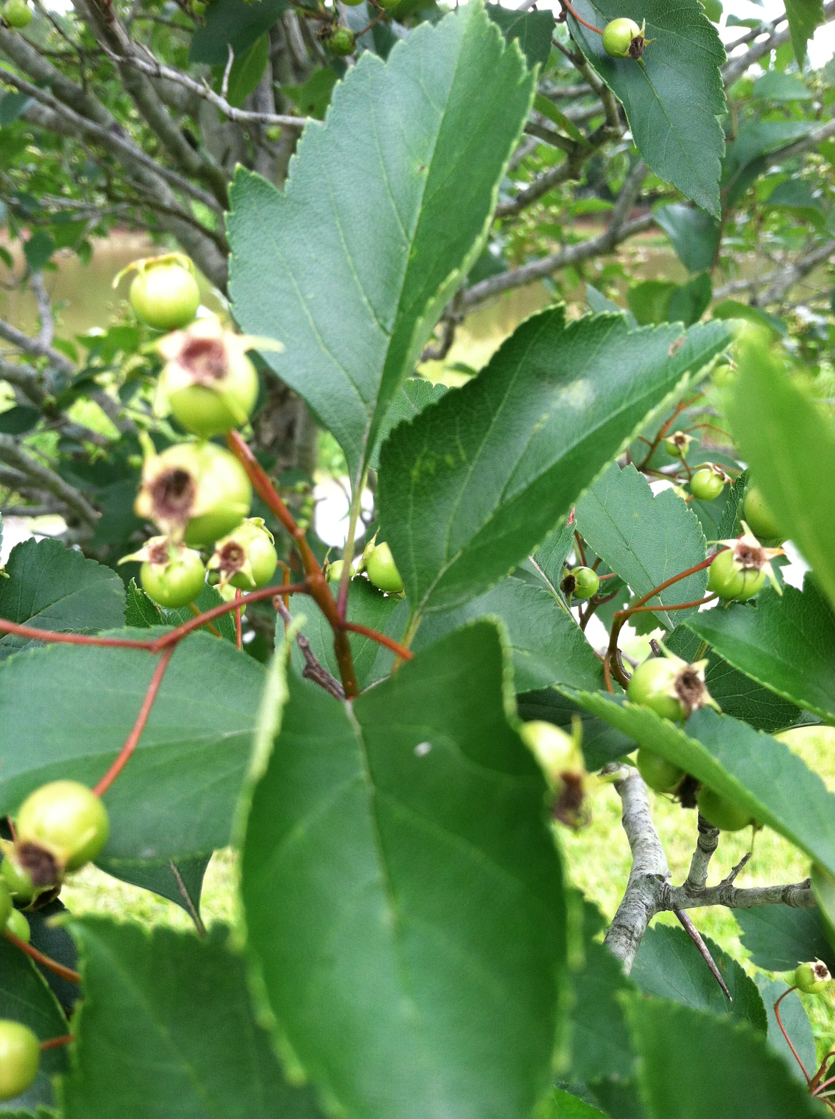
Crabapple

Slide 16
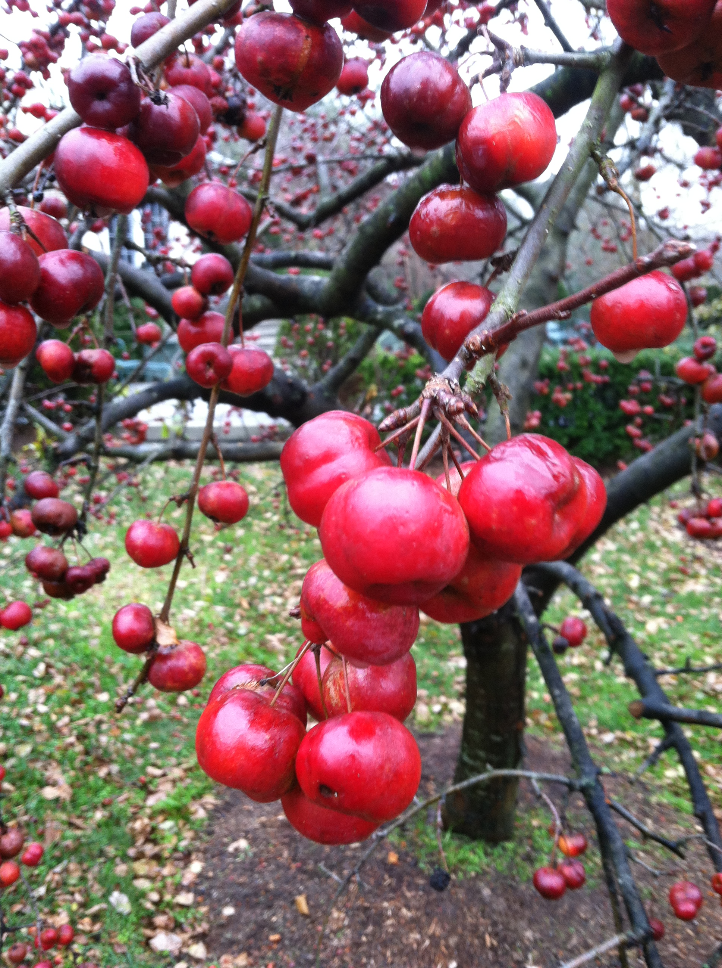
Crabapple

Slide 17
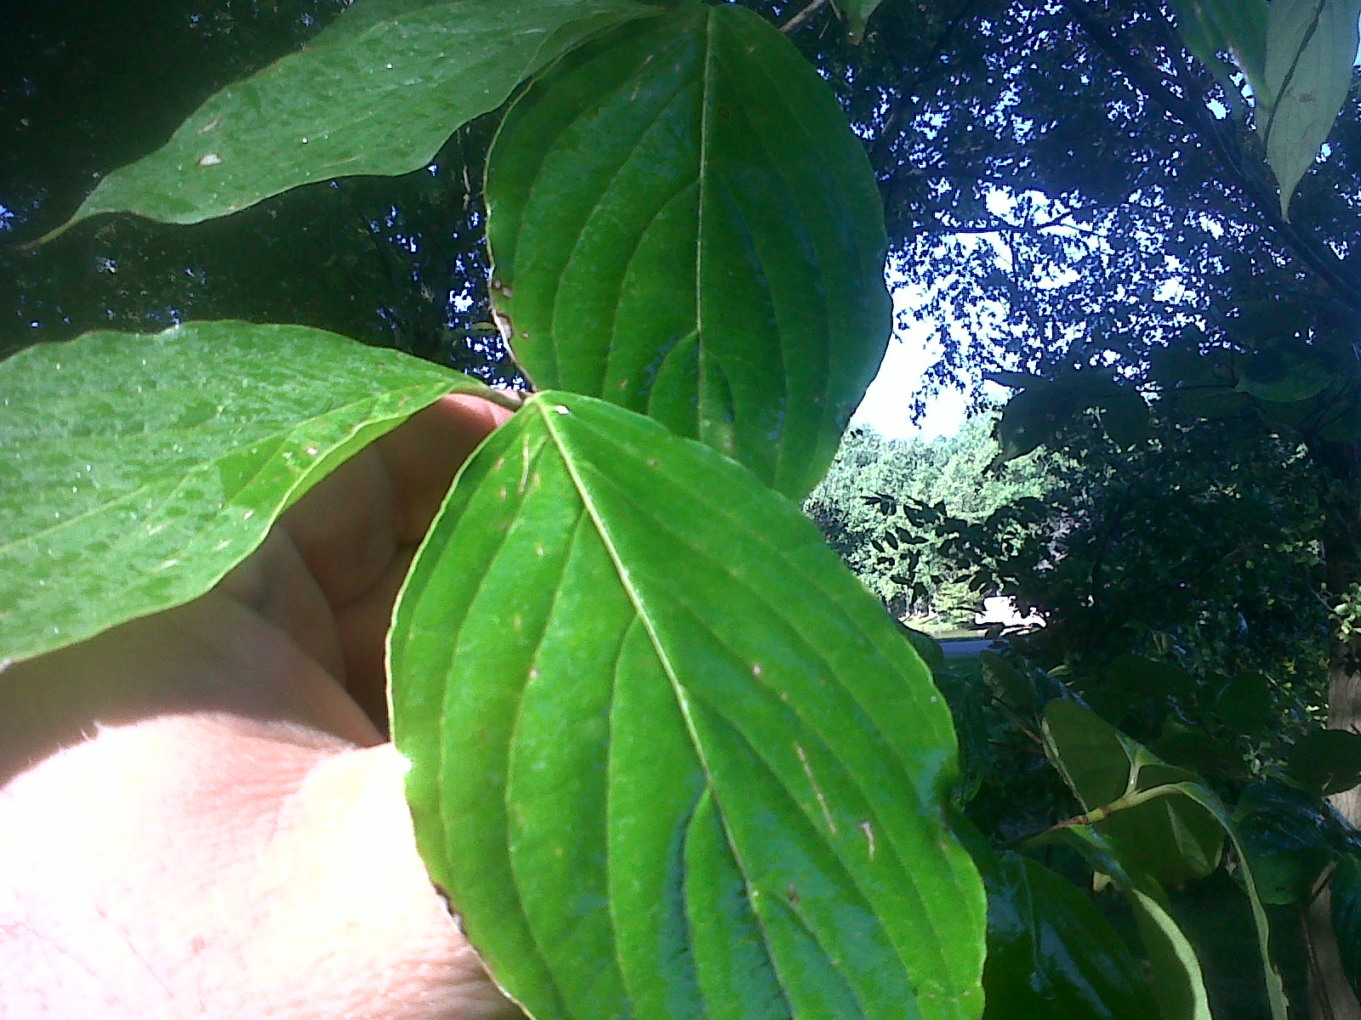
Dogwood

Slide 18
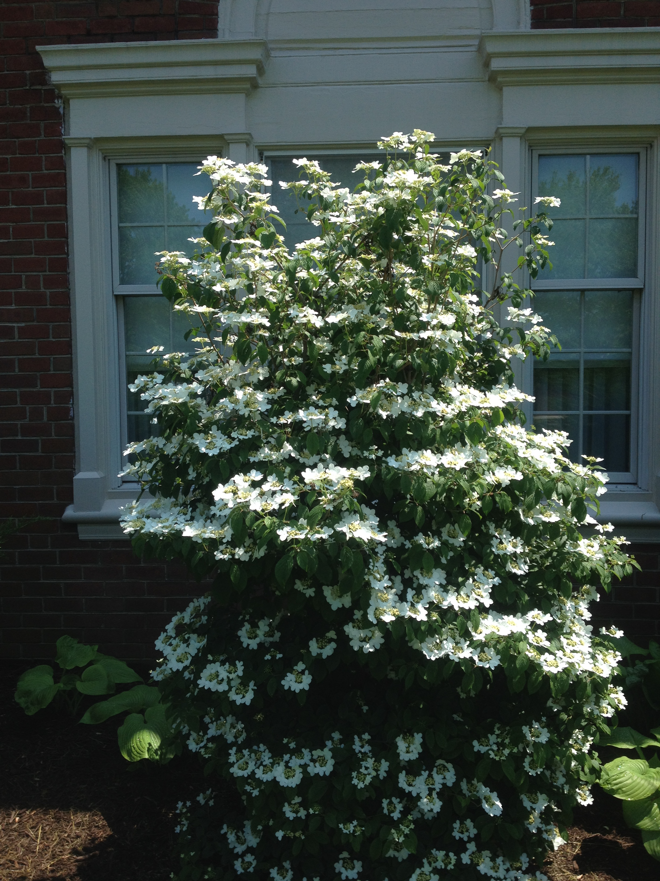
Viburnum Father Gilla

Slide 19
The nitty gritty: Equipment
Notes:
Let’s figure out how many are prospects vs users?

Slide 20
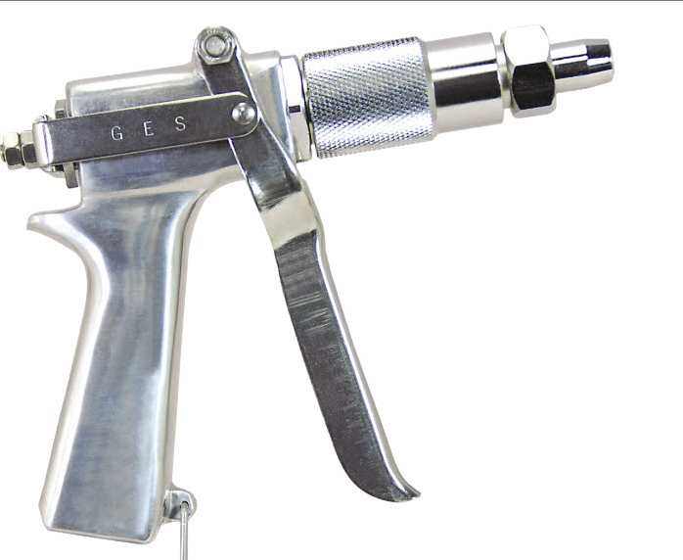
JD-9

Slide 21
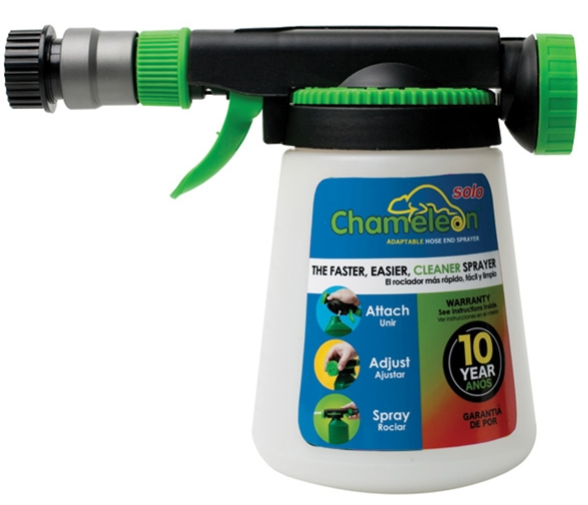
Chameleon

Slide 22
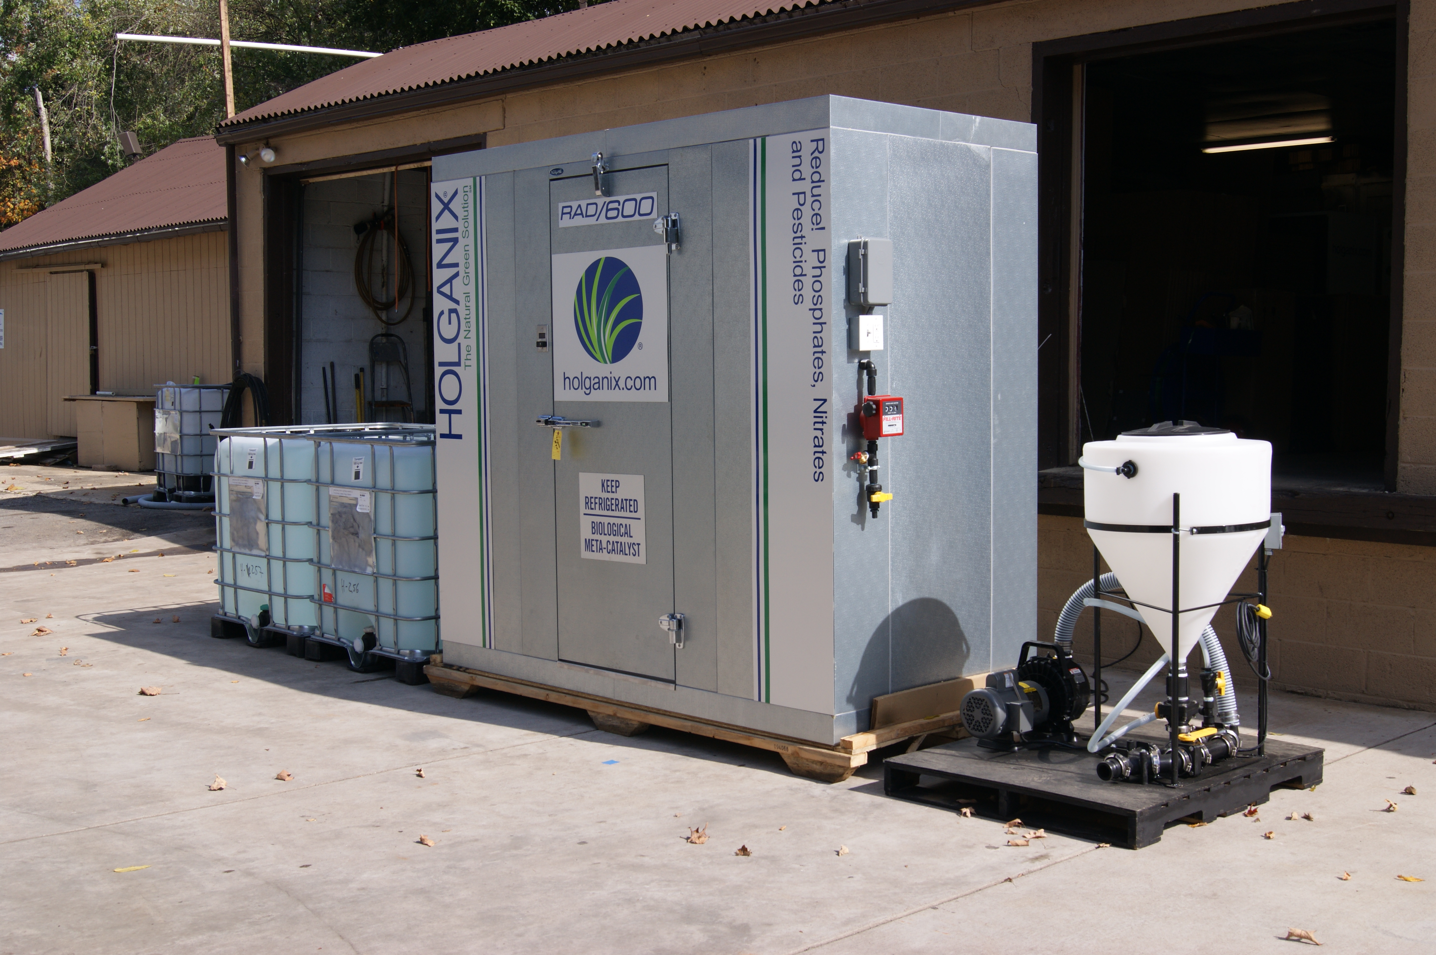
Storage between 33 and 45 degrees
Notes:
Let’s figure out how many are prospects vs users?

Slide 23
Questions?

Slide 24
The nitty gritty: Applying Holganix
Notes:
Let’s figure out how many are prospects vs users?

Slide 25
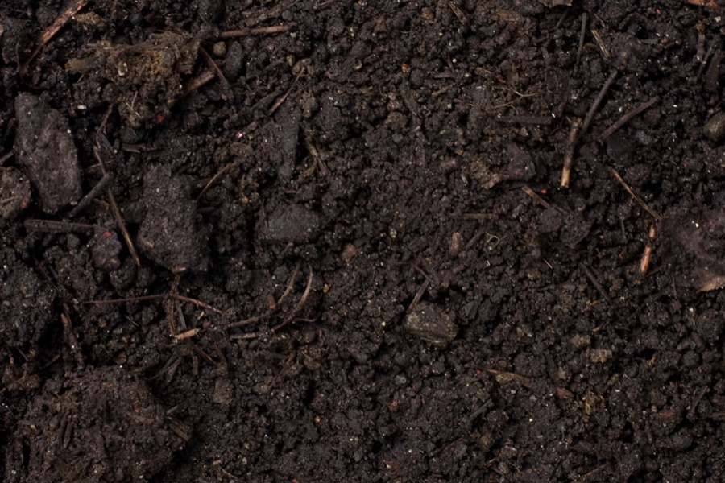
New installation
14 oz/7 gal of spray solution per 1,000 sq ft
Two (2) gallon product diluted to 87.89 gal spray solution (covers 12,667 sq ft)
Spray to runoff covering all plant above ground
Notes:
Just as a refresher for prospects and new-bees

Slide 26
Pre-digging and transplanting
14 oz/7 gal of spray solution per 1,000 sq ft
Two (2) gal product diluted to 87.89 gal spray solution
Drench soil 7 days prior to digging
Drench soil immediately after transplanting
Notes:
Just as a refresher for prospects and new-bees

Slide 27
Stress recovery
14 oz/7gal of spray solution per 1,000 sq ft
Two (2) gal product diluted to 87.89 gal spray solution
Spray to runoff covering all plant above ground
Soil drench
Notes:
Just as a refresher for prospects and new-bees

Slide 28
Tree and shrub maintenance
14 oz/7gal of spray solution per 1,000 sq ft
One (2) gal product diluted to 87.89 gal spray solution
Spray to runoff covering all plant above ground
Drench soil
Notes:
Just as a refresher for prospects and new-bees

Slide 29
Tree specific maintenance
At 12.7 inches DBH, 1 gal diluted to 87.89 spray solution
Increase the amount of Holganix Tree&Shrub proportionately as DBH increases
Drench the soil to the drop point of the tree
Notes:
Just as a refresher for prospects and new-bees

Slide 30
Bare root treatment
Immerse bare roots in Holganix Tree & Shrub
Immerse for four hours, DO NOT EXCEED SIX!
Notes:
Just as a refresher for prospects and new-bees

Slide 31
Questions?

Slide 32
Dr. Bob
Director of Soil and Plant Sciences
rneidermyer@holganix.com
866-56-EARTH

