Slide 1

Everything you need to know about Healthy Grow Infused with Holganix
It’s Bursting with Biology!
Notes:
Tittle slide is up while waiting for audience to arrive.

Slide 2

Agronomy Team
Mike Reed
Sales Representative
Holganix LLC
Notes:
P

Slide 3
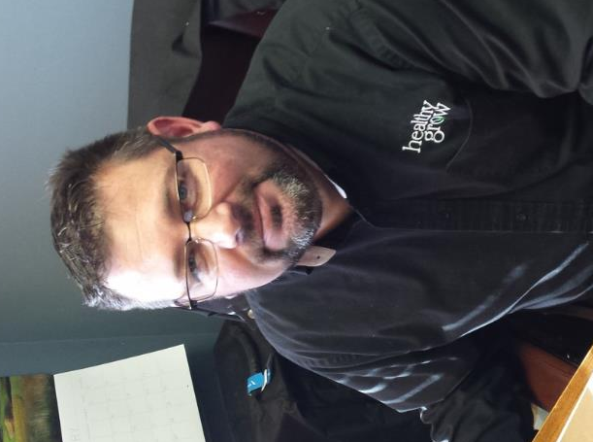
Agronomy Team
Jeff Leuzinger
Sales Manager
Healthy Grow
A Pearl Valley Organics Brand
Notes:
P

Slide 4
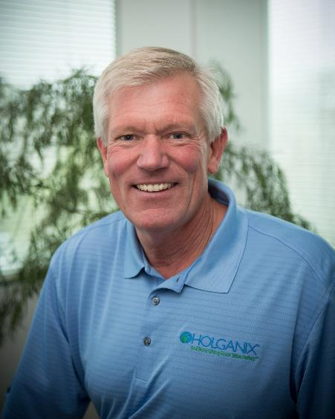
Agronomy Team
Dave Henricksen
Consulting Agronomist,
Advanced Turf Solutions
Notes:
P

Slide 5
Agenda
What is Holganix?
What is Healthy Grow?
Holganix + Healthy Grow
Why is Carbon Important?
Q&A
Audience Polls Throughout

Slide 6
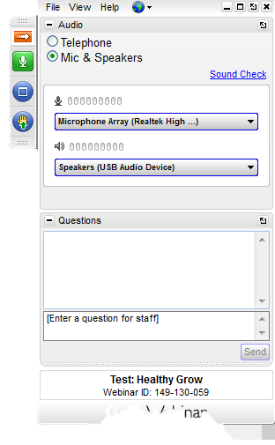
Webinar Semantics
INSERT CONTROL PANNEL PICTURE
If you have a question, type it here!

Slide 7
“
Question one: How many of you currently use Holganix?
“
Notes:
These are audience poll questions

Slide 8
“
Question two: How many of you currently use Holganix Granular?
“
Notes:
These are audience poll questions

Slide 9

What is
Holganix?

Slide 10

Holganix is a 100% organic plant & turf product that promotes strong plant health.

Slide 11
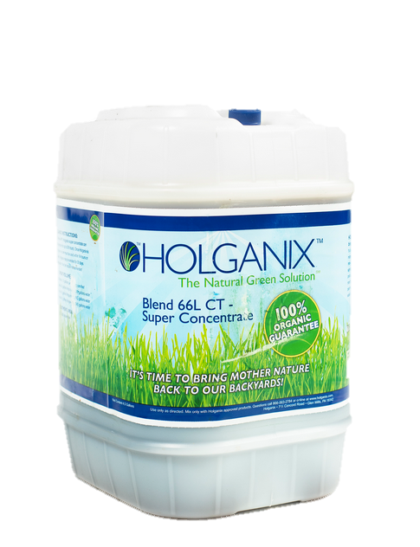
Key Ingredients
Compost tea
Endo & Ecto Mycorrhizae
Trichoderma
Humic, Amino and Fulvic acids
Beneficial Fungi & Bacteria
compost tea, humic and fulvic acids, kelp extract, gluten, endomycorrhizae, ectomycorrhizae, nitrogen fixing bacteria, protozoa, nematodes, saccharomyces cerevisiae, polysaccharide, yucca extract, amino acids, auxin, trichoderma ssp, lingin polymers, secondary and micronutrients, beneficial nematodes
Notes:
Put the jug in

Slide 12


What is
Healthy
Grow?
- Since 1987 -
Notes:
Put the logo in

Slide 13

Aerobically
Composted
Chicken
Manure
OMRI listed
High Microbe Activity
Notes:
Make the connection the chicken and the egg.

Slide 14
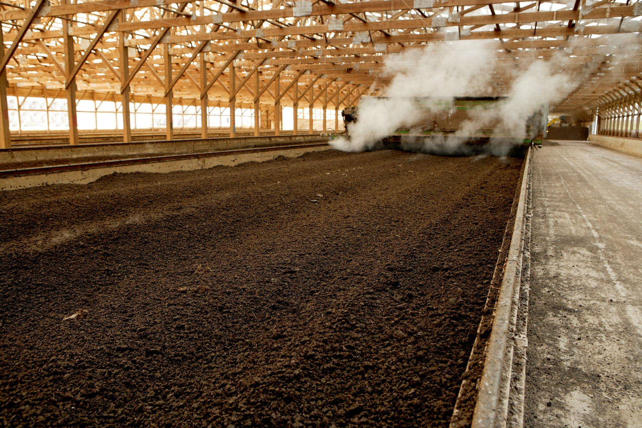
Manufacturing Process
45-60 days
140 – 160 degrees F
Kills weed seeds and pathogens
Preserves beneficial biology
Moisture maintained at 25-35%

Slide 15
Brown Patch Study
*By the Chicago District Golf Association

Slide 16
Dollar Spot Study
*By the Chicago District Golf Association

Slide 17
Root Length University Study
*By Iowa State University

Slide 18

Healthy Grow
+
Holganix

Slide 19


Healthy Grow Infused with Holganix
+
Natural Nutrients
Natural Biology
Diverse Biology
Natural Catalyst
= A Perfectly Synergistic Relationship
A Natural Approach for
Balanced Soils & Healthy Plants
Notes:
As opposed to the plus put the infused

Slide 20

When Holganix is added, Healthy Grow “Gets Wings” and results are amplified.

Slide 21
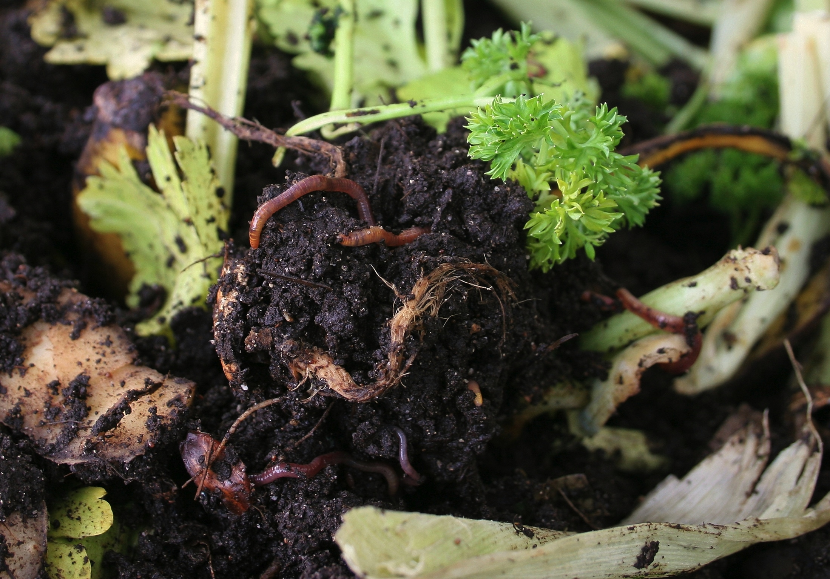
Balanced Soil
C:N = 20:1

Slide 22
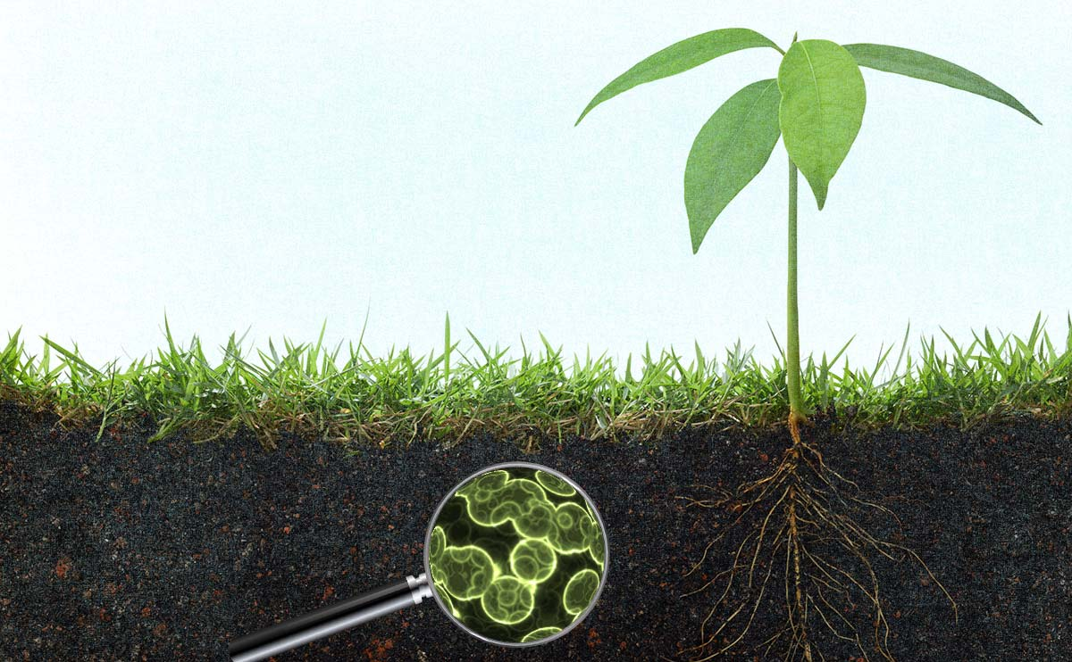
Healthy Grow provides energy (carbon) to sustain the microorganisms contained in Holganix, helping to build balanced soils and promote healthy plants.

Slide 23
Balanced Soil - Benefits
Promotes active and diverse soil biology
    Carbon (carbohydrates) = energy
    Nitrogen (protein) = cellular structure
Reactivates and sustains naturally occurring biological cycles – Nitrogen + Carbon
Increases soil exchange capacity

Slide 24
Balanced Soil - Benefits
Improves soil structure – facilitating air and water movement
Increases soil available essential nutrients
Enhances root function – increases access to nutrients and water

Slide 25
Balanced Soil - Benefits
Suppresses diseases and reduces stress
Improves water management efficiencies
Reduces excess soil bicarbonates and sodium accumulation
Increases environmental stewardship

Slide 26
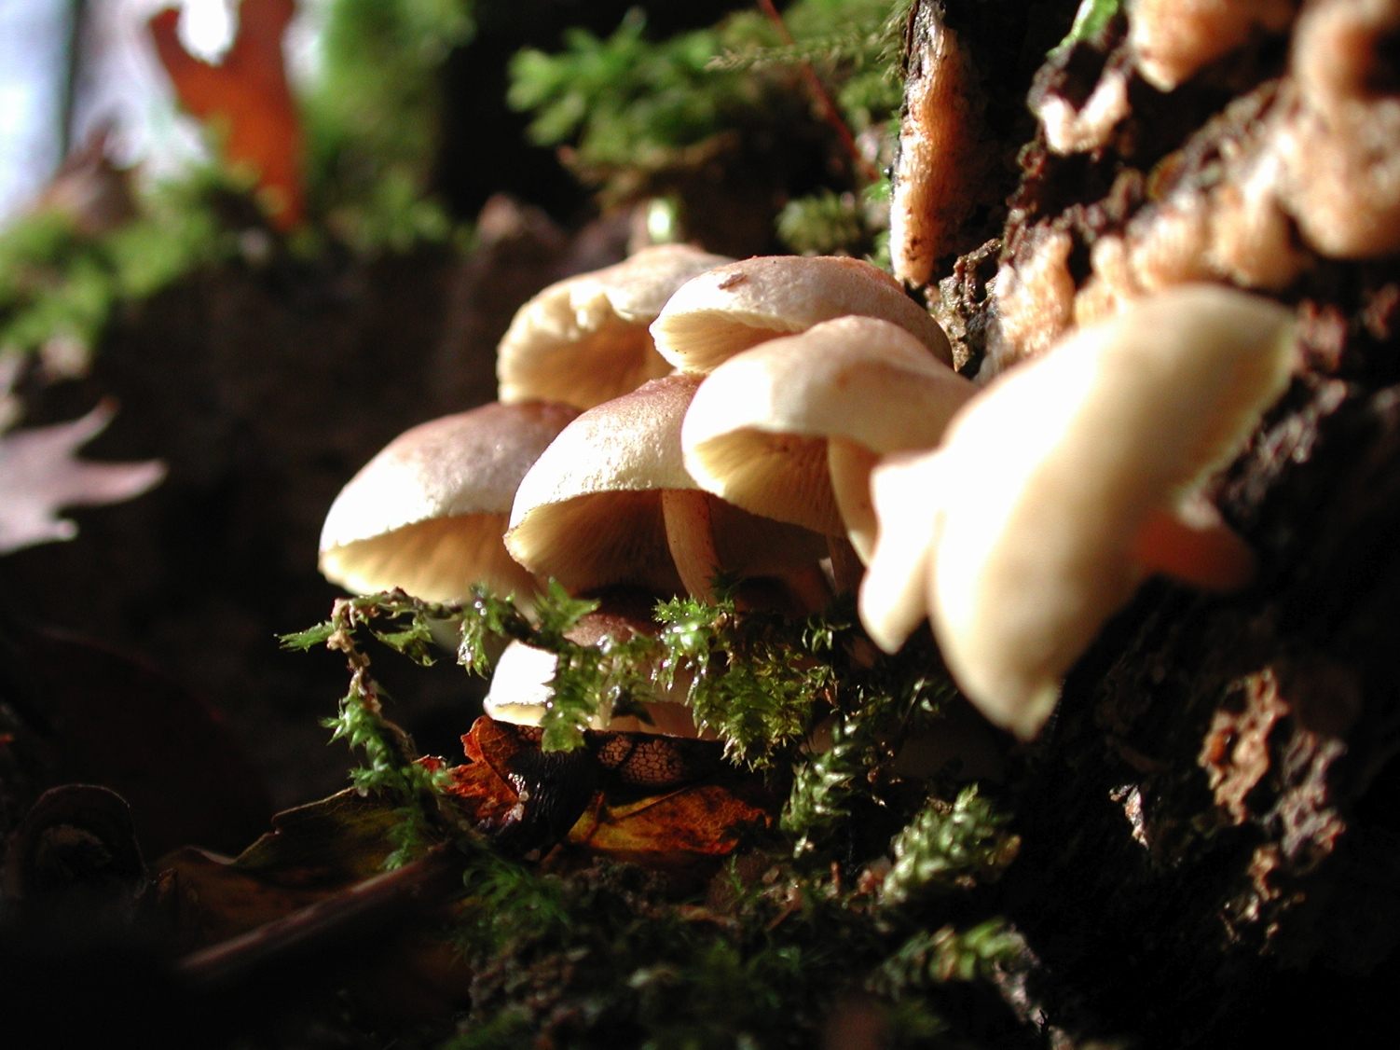
Carbon Based Fertility
Balanced carbon + nitrogen supports soil food web
Available carbon buffers decomposition of SOM
Sequester and recycle soil stable carbon
Notes:
20:1 ratio

Slide 27
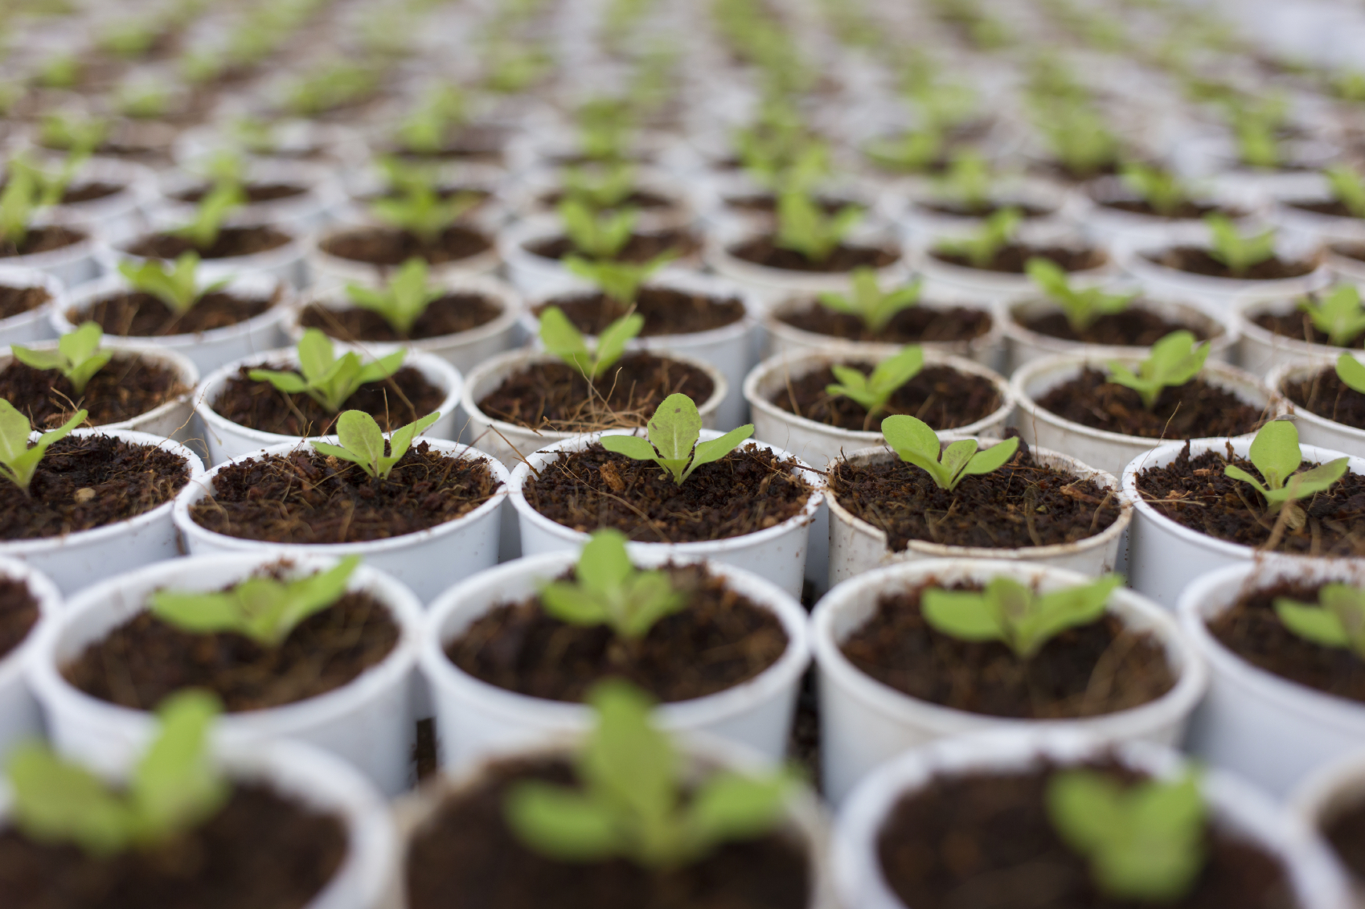
Product Information

Slide 28
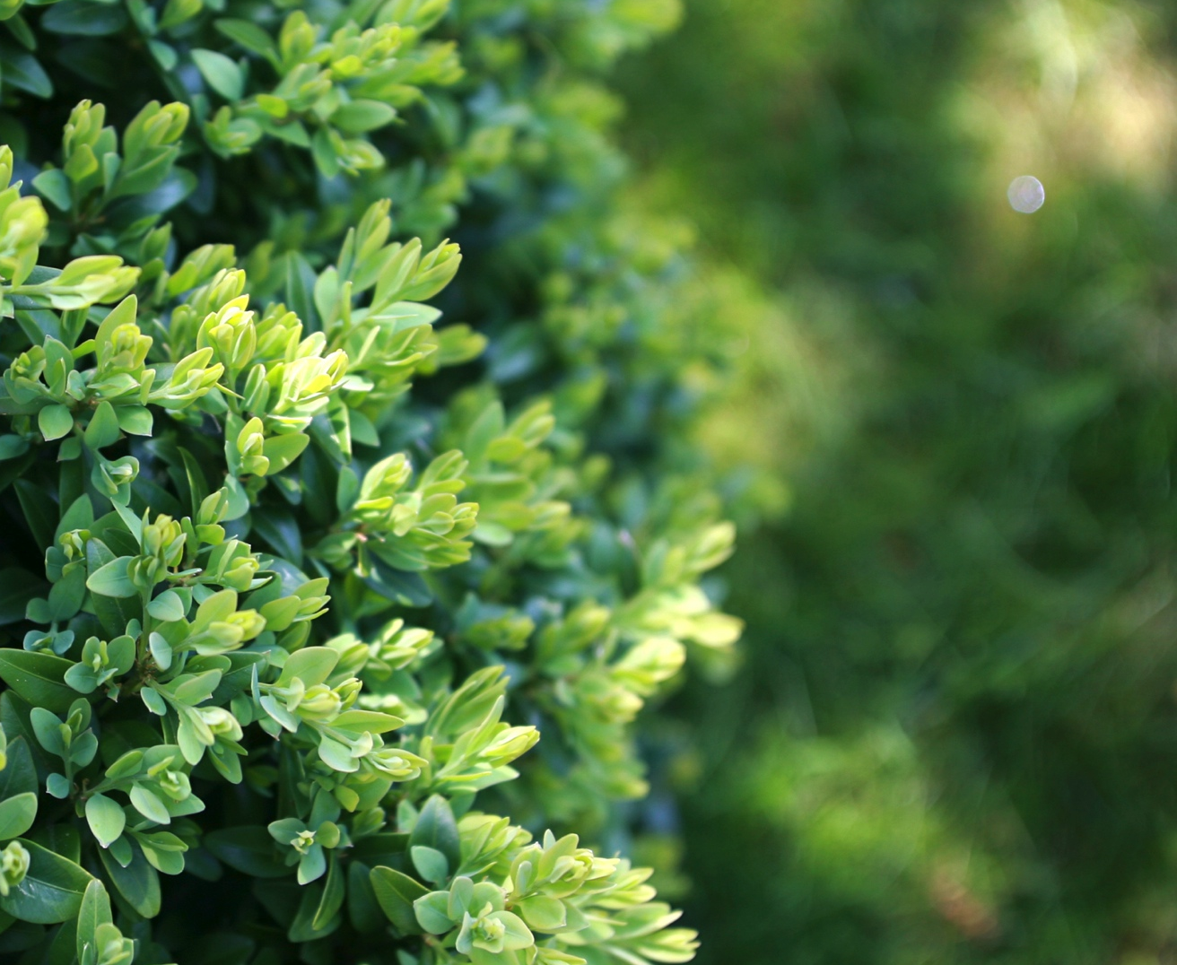
Where can you use it?
Turf
Aerification
Landscape beds
Sod, seedbeds, sprigging
Divot mix
Potting mix

Slide 29
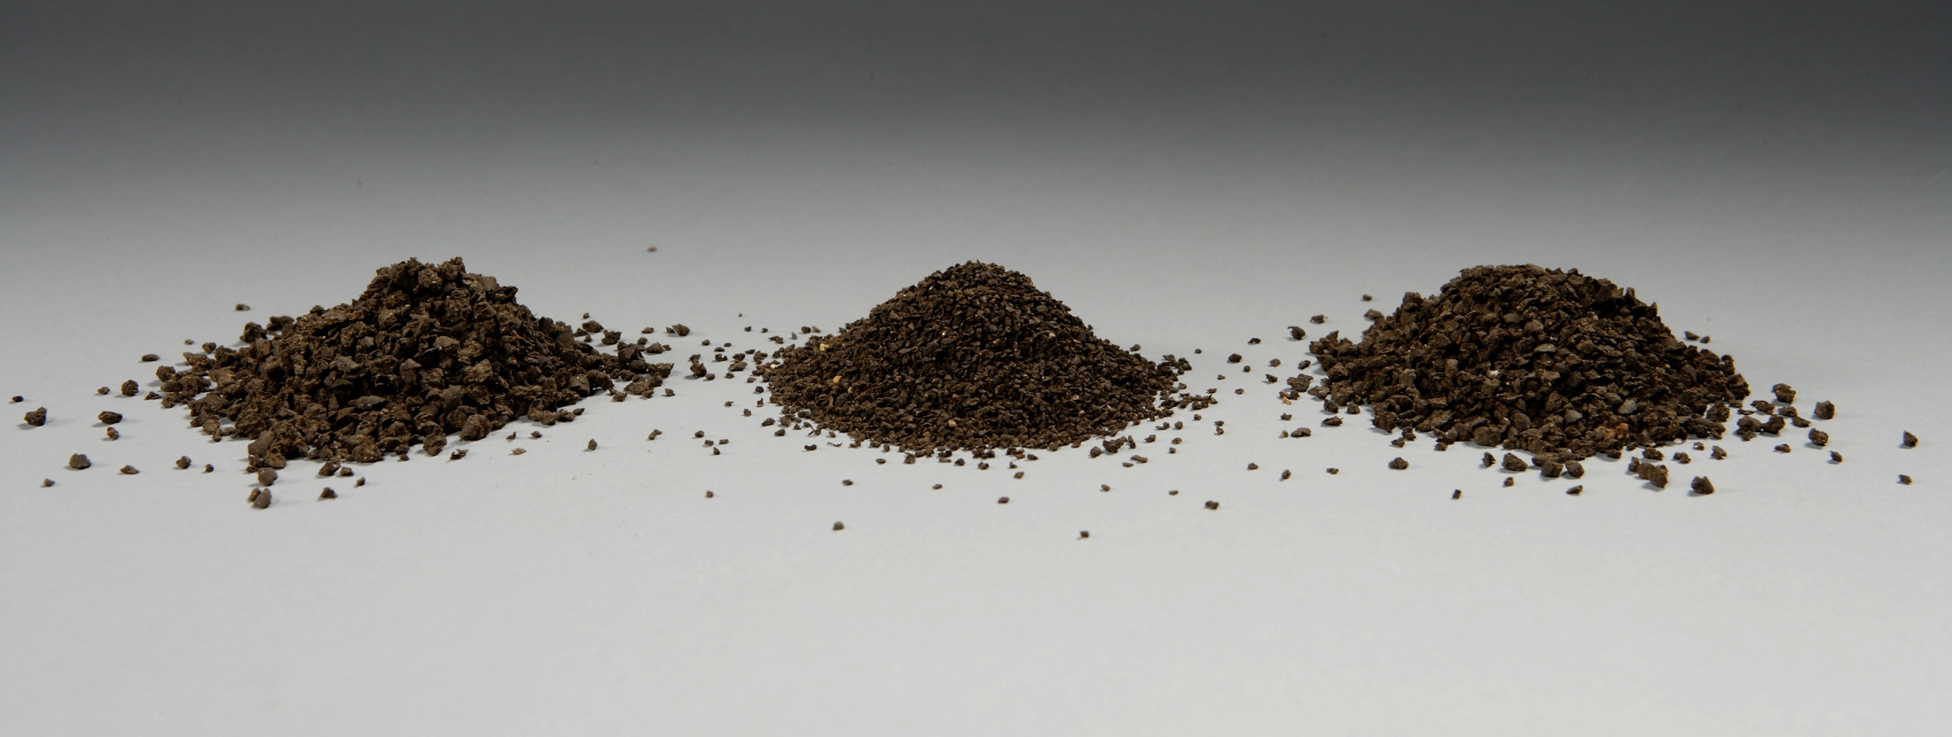
Mini Size/Greens Grade - 90 SGN
Mid Size - 180 SGN

Slide 30
Holganix + Healthy Grow Analysis Options
2-4-3 + Holganix
5-2-3 + Holganix
7-9-5 + Holganix
10-3-2 + Holganix
8-3-5 + Holganix
90 & 180 SGN
90 & 180 SGN
180 SGN
180 SGN
90 & 180 SGN
Holganix, ACCM, 8% Ca, 100% Organic
Holganix,
ACCM, Iron Sulfate, Sulfate of Potash, Molasses, Feather Meal, 60% Slow Release
Holganix, ACCM, Urea, MAP, Sulfate of Potash, 60% Organic
Holganix, ACCM, Urea, Ammonium Sulfate, 60% Organic
Holganix,
ACCM,
Ammonium Sulfate, Urea, MAP, Sulfate or Potash, Iron Sulfate, Molasses, 64% Organic
All Purpose
Turf, Landscape Beds, Sod Starter, Golf, Divot Mix, Aerification, Potting Mix
Great for Higher N & 100% Organic
Good Turf/Field Product, Flower & Landscape Beds
High Performance Starter Fertilizer
Turf, Lawn Care, Annuals
The Right Ingredients for The Right Price
Lawn Care’s Best Bang-For-Your-Buck. The most Holganix & Nitrogen
A Golf Product
Used extensively during tee & green aerification, tee nutrition, late fall fairways & spring app
Notes:
Holganix infused

Slide 31
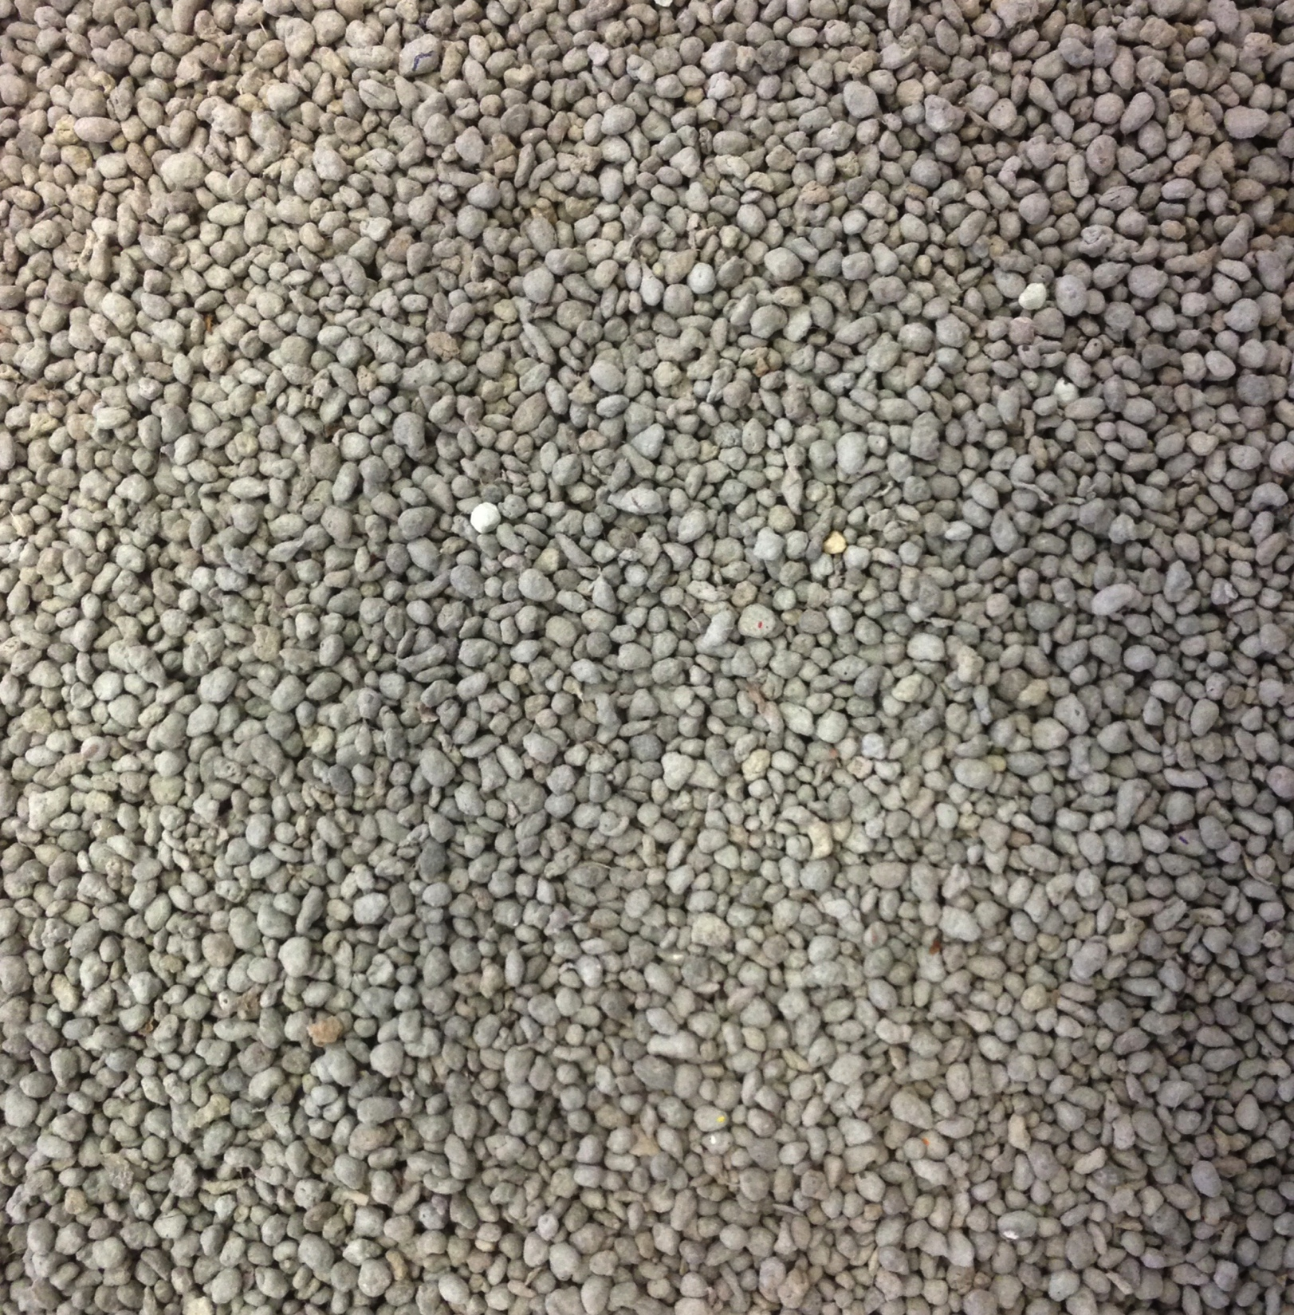
What else you need to know
Certain analyses are still available with Biodac due to Phosphorous regulations.
Visit www.holganix.com/products/granular for more information
Notes:
Some states phosphorus is allowed in natural sources
Except from law if you are using natural sources like illinois
You’ve gotta know your local regulations.

Slide 32

Audience Questions:
Type your questions in the Chat Box!

Slide 33
Conclusion
Please take our survey!
Look for a follow up email with:
  A recorded version of this webinar
  Resources and information mentioned during the webinar

Slide 34

Additional Questions?
Reach out any time!
Mike Reed
Email: mreed@Holganix.com
Phone: 973-459-1369
Website: www.holganix.com
Notes:
Change this picture

Slide 35

Thank you!
Notes:
Tittle slide is up while waiting for audience to arrive.

Slide 36
EXTRA SLIDES FROM THIS POINT ON

Slide 37

Pearl Valley Eggs:
1.1 million hens
800,000- 950,000 eggs a day
Important:
Feed mill on site
Water consumption recorded
Automated controls

Slide 38

Healthy Grow
+
Holganix

Slide 39

Everything you need to know about Holganix Granular with Healthy Grow
Notes:
Tittle slide is up while waiting for audience to arrive.

Slide 40
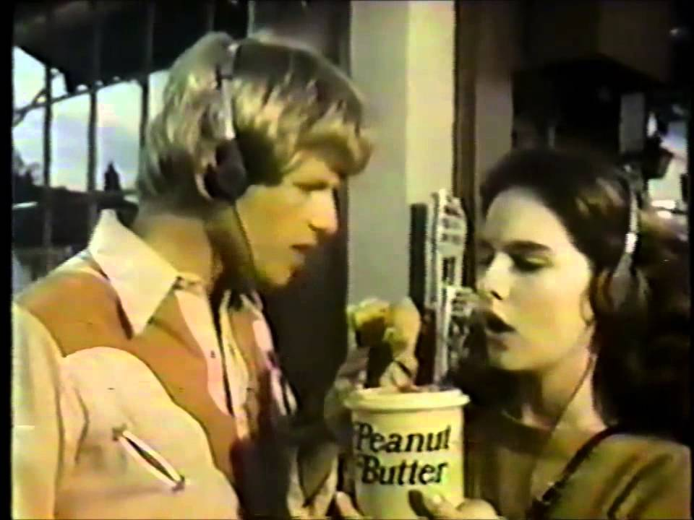
Healthy Grow
+
Holganix
Notes:
Don’t know which one you guys want

