Slide 1

Strengths. Weaknesses. Opportunity. Threats.
Are you ready for 2015?
Notes:
Tittle slide is up while waiting for audience to arrive.

Slide 2
Video
Kid talks finances:
http://www.youtube.com/watch?v=UZq1bHUlftE

Slide 3

Barrett Ersek
CEO
Bersek@holganix.com
866-56-EARTH

Slide 4
Agenda
P&L 101
Key metrics to growing your business
Discussion

Slide 5
What is a SWOT analysis?

Slide 6
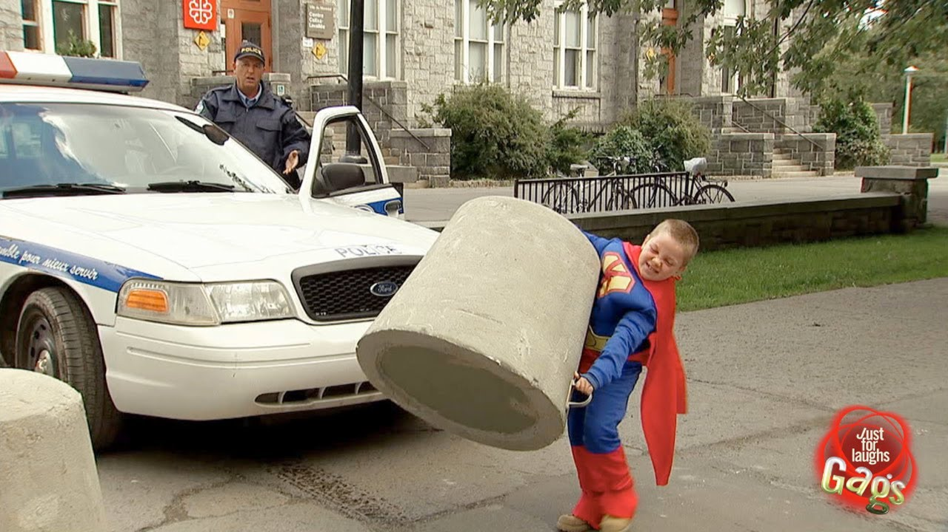
What’s your company’s
super hero strength?

Slide 7
Strengths
What is it that makes your company so special?
What do you do better than the competition?
What’s you’re purple cow?

Slide 8
Suggestions
Do you have more years in the industry than most?
Is your sales team the best?
Are you awesome at designing marketing campaigns?
Are you super efficient?
Are your services of better quality than the rest?

Slide 9

What’s your kryptonite? Or weaknesses?

Slide 10
Weaknesses
What do you suck at?

Slide 11

What opportunities
are there?

Slide 12
Opportunities
Are there industry wide opportunities you can take advantage of?

Slide 13
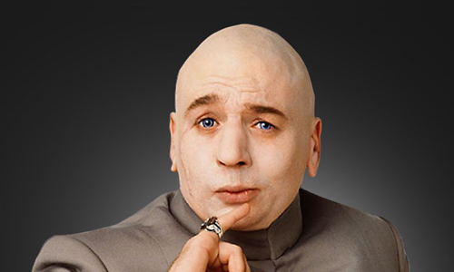
What opportunities
are there?
Threats?

Slide 14
How fast can you
grow your business?

Slide 15

Key metrics to consider

Slide 16
COGS:
Direct costs attributed to the production of services sold.

Slide 17
Gross Margin:
Percentage of sales revenue
retained after incurring COGS

Slide 18
Gross Margin Percentage:
Total sales revenue – COGS/
total sales revenue

Slide 19
But…
Not all customers are the same

Slide 20

Golden
Streets

Slide 21
Marketing ROI

Slide 22
Marketing ROI:
Gross margin/Cost per Sale = Time it takes to recoup marketing costs

Slide 23
Cost per Sale:
Target example: $100

Slide 24
Cost per Lead:
Target example: $33

Slide 25

Get obsessed
Notes:
Extra

Slide 26
Questions?

Slide 27
Barrett Ersek
CEO
Bersek@holganix.com
866-56-EARTH

